Slide 1
Implementing Ethics: Developing Trustworthy AI
Carol J. Smith
Sr. Research Scientist - Human-Machine Interaction
Twitter: @carologic @sei_etc

Slide 2
Legal
Copyright 2020 Carnegie Mellon University.
This material is based upon work funded and supported by the Department of Defense under Contract No. FA8702-15-D-0002 with Carnegie Mellon University for the operation of the Software Engineering Institute, a federally funded research and development center.
The view, opinions, and/or findings contained in this material are those of the author(s) and should not be construed as an official Government position, policy, or decision, unless designated by other documentation.
References herein to any specific commercial product, process, or service by trade name, trade mark, manufacturer, or otherwise, does not necessarily constitute or imply its endorsement, recommendation, or favoring by Carnegie Mellon University or its Software Engineering Institute.
NO WARRANTY. THIS CARNEGIE MELLON UNIVERSITY AND SOFTWARE ENGINEERING INSTITUTE MATERIAL IS FURNISHED ON AN "AS-IS" BASIS. CARNEGIE MELLON UNIVERSITY MAKES NO WARRANTIES OF ANY KIND, EITHER EXPRESSED OR IMPLIED, AS TO ANY MATTER INCLUDING, BUT NOT LIMITED TO, WARRANTY OF FITNESS FOR PURPOSE OR MERCHANTABILITY, EXCLUSIVITY, OR RESULTS OBTAINED FROM USE OF THE MATERIAL. CARNEGIE MELLON UNIVERSITY DOES NOT MAKE ANY WARRANTY OF ANY KIND WITH RESPECT TO FREEDOM FROM PATENT, TRADEMARK, OR COPYRIGHT INFRINGEMENT.
[DISTRIBUTION STATEMENT A] This material has been approved for public release and unlimited distribution. Please see Copyright notice for non-US Government use and distribution.
This material may be reproduced in its entirety, without modification, and freely distributed in written or electronic form without requesting formal permission. Permission is required for any other use. Requests for permission should be directed to the Software Engineering Institute at permission@sei.cmu.edu.
DM20-0164

Slide 3
Goal: Create AI systems that are safe and trustworthy

Slide 4
Early, purposeful work
Not just algorithms
Conduct, interactions, intents
Notes:
https://www.linkedin.com/pulse/coming-tech-backlash-ross-mayfield
Tech still has time. Lean your products towards augmentation and job creation. Solidify your principles for what is humanely right against fear-mongering and scapegoating. Foster education, and not just what worked for you, but what junior colleges can do to help people transition. Tech company policy needs to go beyond the regulations that risk a single company wants to manage, and reflect it’s inherently progressive value set. Admit disruption is a bad word, and at least cause-relate your marketing and mission.
Does it Delight? Does it Pay? Does it Parse? Ethics for Digital Makers https://medium.com/@lwelchman/does-it-delight-does-it-pay-does-it-parse-251b36efb5cd#.s43if7hhd
"This will be a hard shift. Our digital maker culture often demands that we make, and make, and make, never turning back to see the messes we might have created. Some of those messes are catching up to us and it’s important to pay attention and realize that knowledge and potential solutions are available to us. We can and must have the conversation and modulate our product development practices to ensure an ethically sound online experience for all of us. How can we teach machines to distinguish right from wrong when we’re not really clear on those answers ourselves?"
Technology is changing faster than ever, and that can lead to fear, uncertainty, doubt, anger, and unrest.
Examples abound in the tech industry of unethical behavior, arrogance, and lack of empathy. Culture and leadership have reputation for being unethical.
Technology is not neutral, but too often we jump into the new and the cool before considering the ramifications.
Ethical decisions are often not starkly good or bad, but nuances of behavior and habits. Just walking away isn’t the answer.
Pace of change
Avoid creating fear, uncertainty, doubt, anger, and unrest
Breadth of implications
Unintended consequences, ramifications
Understand nuances of behavior and habits
Consider ramifications
Don’t jump into the new and the cool too quickly
Counter perceptions in the industry
Unethical behavior, arrogance, and lack of empathy

Slide 5
Start with a diverse team
Gender, race, culture, education (school, program, etc.), thinking process, disability status, and more…
Image: https://www.flickr.com/photos/byrawpixel/45739276192/in/photostream/
Created with love by rawpixel.com.
Download this image in high resolution under Creative Commons 0 at www.rawpixel.com.
Notes:
Non-typical schools, non-typical careers,
POC, LGBTQ, women (52% of world).
How People with Disabilities Use the Web: Overview
https://www.w3.org/WAI/intro/people-use-web
WAI-AGE Task Force of the Education and Outreach Working Group (EOWG), W3C
“When we do not design for people with disabilities we are being ableist” - Anne Gibson @perpendicularme #ias18 Roundtable on Ethics
Hire/work with people affected by bias
https://www.flickr.com/photos/byrawpixel/45739276192/in/photostream/
Created with love by rawpixel.com.
Download this image in high resolution under Creative Commons 0 at www.rawpixel.com.

Slide 6
Diverse, Talented and Multi-Disciplinary
Includes skill set and problem framing approach
Data Scientists
Machine learning experts
Programmers
System architects
Product managers, etc.
(context dependent)
Notes:
Curiosity experts include: HCI, HMI, cognitive psychologists, digital anthropologists, and UX researchers

Slide 7
Not lowering bar – extending it

Slide 8
Curiosity Experts
Understand
Situation
Abilities of people who will use system
How system will be used
Activate curiosity in others via UX activities
Social scientists, ethicists and more…
Notes:
Curiosity experts include: HCI, HMI, cognitive psychologists, digital anthropologists, and UX researchers

Slide 9
High value in diverse teams
Focus more on facts
Process facts more carefully
More innovative
“…become more aware of their own potential biases”
Why Diverse Teams Are Smarter. Harvard Business Review. https://hbr.org/2016/11/why-diverse-teams-are-smarter
Notes:
David Rock, Heidi Grant. 2019. Why Diverse Teams Are Smarter. (4 November, 2019). Retrieved September 13, 2019 from: https://hbr.org/2016/11/why-diverse-teams-are-smarter

Slide 10
Great Minds Think Different
Notes:
How can we best identify the biases within ourselves and our teams?
What tools and processes to control for bias we can introduce into our processes?
Where do biases emerge in our work?
Start with understanding your own bias
Don’t fall into the illusion of complete objectivity
Don’t be afraid to acknowledge bias

Slide 11
Inclusive Workplace Requirements
Representatively diverse leadership = retention
Individuals differences are acknowledged and accepted
Bring "whole selves" to work
Welcoming community environment
Feel valued, connected, that we belong
Notes:
If not yet in place, promote people early or hire from outside
Inclusivity resources from Forbes:
What An Inclusive Workplace Actually Looks Like, And Seven Ways To Achieve It
By Laura Hamill, Forbes Councils Member, Feb 4, 2019. https://www.forbes.com/sites/forbeshumanresourcescouncil/2019/02/04/what-an-inclusive-workplace-actually-looks-like-and-seven-ways-to-achieve-it/#21ec706e316b
Belonging In The Workplace: A New Approach to Diversity And Inclusivity. By Dr. Pragya Agarwal. Forbes. August 26, 2019
https://www.forbes.com/sites/pragyaagarwaleurope/2019/08/26/belonging-in-the-workplace-a-new-approach-to-diversity-and-inclusivity/

Slide 12
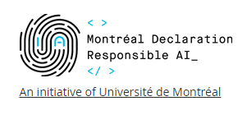
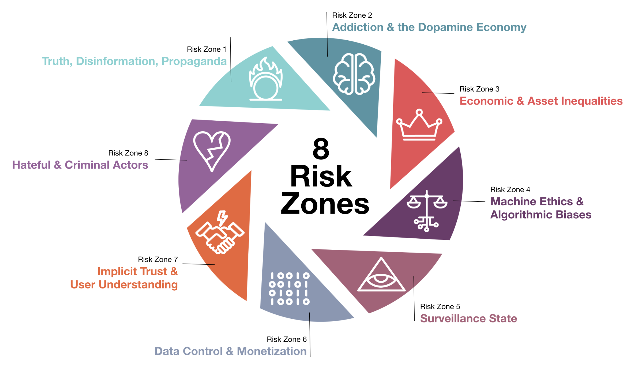
Adopt Technology Ethics
Harmonize cultural variations
Balance to pace of change, industry pressure
Explicit permission to consider and question breadth of implications
Notes:
What is too far?
What are you including?
socio-economic, cross cultural, international team
Links
Precedence - principles and codes
Université de Montréal. 2018. Montréal Declaration for a responsible development of artificial intelligence. 2018. Retrieved September 13, 2019 from: https://www.montrealdeclaration-responsibleai.com/the-declaration
ACM Code of Ethics and Professional Conduct - The Official Site of the Association for Computing Machinery's Committee on Professional Ethics: https://ethics.acm.org/
AI Now Institute - https://ainowinstitute.org/
Medium article: After a Year of Tech Scandals, Our 10 Recommendations for AI
Let’s begin with better regulation, protecting workers, and applying “truth in advertising” rules to AI https://medium.com/@AINowInstitute/after-a-year-of-tech-scandals-our-10-recommendations-for-ai-95b3b2c5e5
IBM Medium Article: Everyday Ethics for Artificial Intelligence: a Practical Guide for Designers and Developers by Adam Cutler, IBM Distinguished Designer, Artificial Intelligence Design; Milena Pribić, IBM Designer, Artificial Intelligence Design; and Lawrence Humphrey, IBM Designer, Artificial Intelligence Design: https://medium.com/design-ibm/everyday-ethics-for-artificial-intelligence-75e173a9d8e8
Google: our principles - https://blog.google/technology/ai/ai-principles/
Microsoft AI Principles - https://www.microsoft.com/en-us/ai/our-approach-to-ai
Everyday Ethics for Artificial Intelligence: A Practical Guide for Designers and Developers ibm.biz/everydayethics

Slide 13
Coalesce on Shared Set of Technology Ethics
1. Well-being
2. Respect for autonomy
3. Protection of privacy and intimacy
4. Solidarity
5. Democratic participation
6. Equity
7. Diversity inclusion
8. Prudence
9. Responsibility
10. Sustainable development
Montréal Declaration for a responsible development of artificial intelligence. https://www.montrealdeclaration-responsibleai.com/the-declaration
Notes:
Université de Montréal. 2018. Montréal Declaration for a responsible development of artificial intelligence. 2018. Retrieved September 13, 2019 from: https://www.montrealdeclaration-responsibleai.com/the-declaration

Slide 14
Diverse, inclusive leaders Diverse, Multi-Disciplinary Teams Shared Tech Ethics

Slide 15
UX Framework
Designing Trustworthy AI

Slide 16
How do we get there?
?
Trustable, Ethical AI
Montréal Declaration for a responsible development of artificial intelligence. https://www.montrealdeclaration-responsibleai.com/the-declaration
Notes:
Accountable, De-risked, Respectful, Secure, Honest, Usable
Université de Montréal. 2018. Montréal Declaration for a responsible development of artificial intelligence. 2018. Retrieved September 13, 2019 from: https://www.montrealdeclaration-responsibleai.com/the-declaration

Slide 17
Conversations for Understanding
UX Framework guides AI development teams
Difficult Topics
What do we value?
Who could be hurt?
What lines won’t our AI cross?
How are we shifting power?*
How will we track our progress?
*“How is this ML model shifting power?" @riakall #NeurIPS2019
Notes:
What is too far?
What are you including?
socio-economic, cross cultural, international team
*“How is this ML model shifting power?" https://twitter.com/riakall @riakall #NeurIPS2019
Initially inspired by
“3 guiding principles for ethical AI, from IBM CEO Ginni Rometty” by Alison DeNisco. January 17, 2017, Tech Republic
http://www.techrepublic.com/article/3-guiding-principles-for-ethical-ai-from-ibm-ceo-ginni-rometty/

Slide 18
New uncomfortable work “Be uncomfortable”
- Laura Kalbag Ethical design is not superficial.
Notes:
If we don’t ask tough questions, who will?
“Be uncomfortable.”
Ethical design is not superficial. By Laura Kalbag
https://laurakalbag.com/ethical-design-is-not-superficial/
Copyright © Laura Kalbag, 2019. RSS feeds

Slide 19
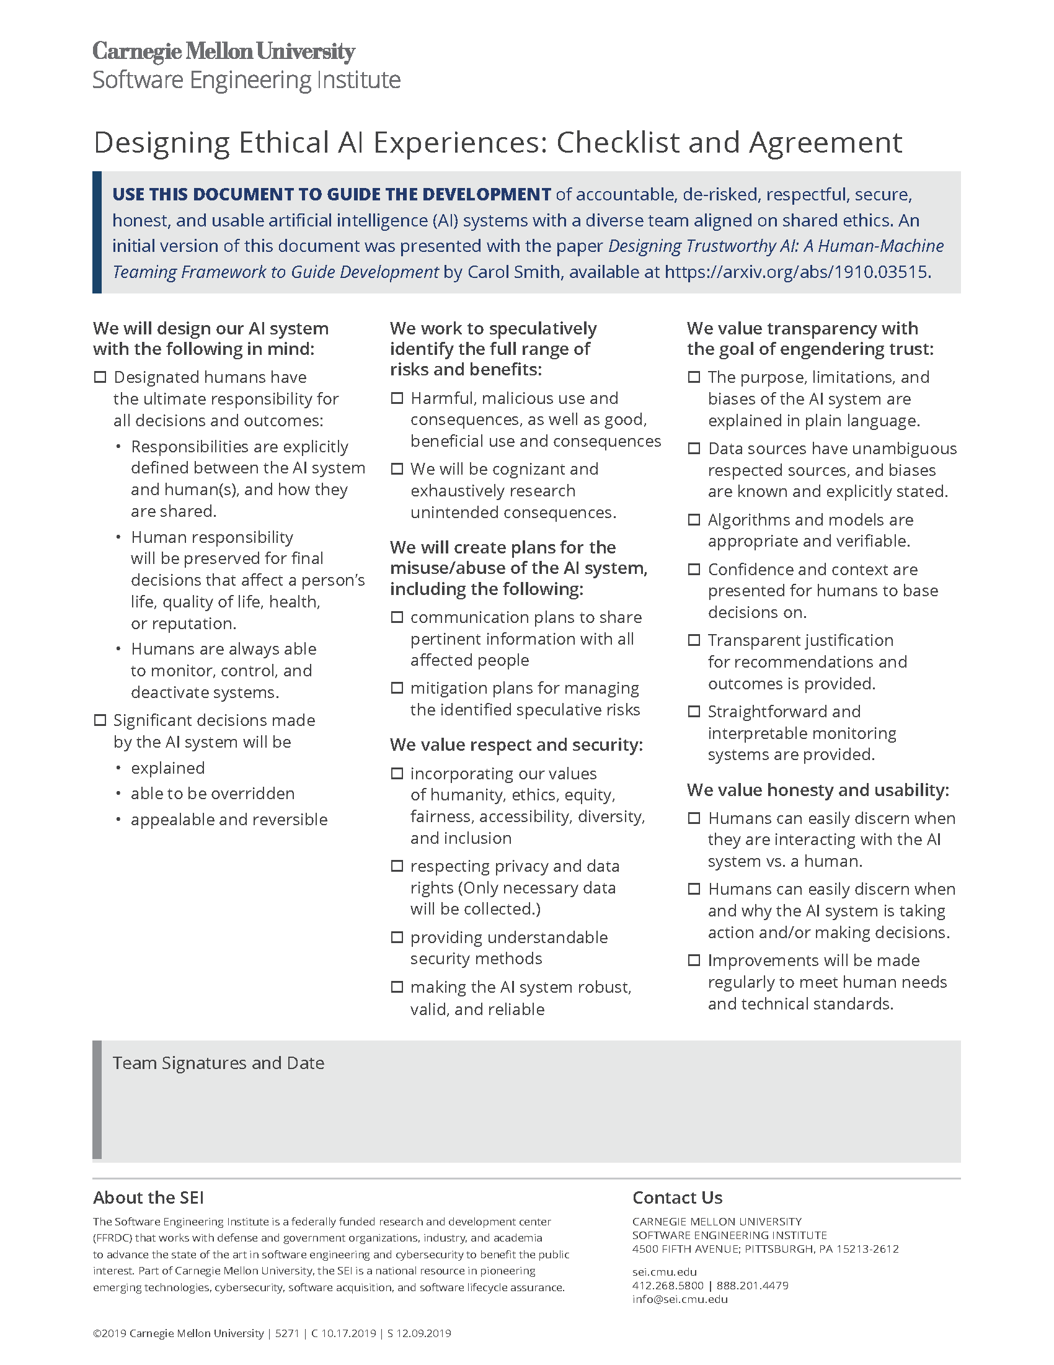
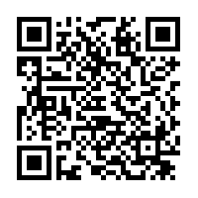
Prompt conversations with a checklist
Paired with Technical Ethics
Bridge gap between “do no harm” and reality
Reduce risk and unwanted bias
Mitigation planning
Support inspection
Checklist and Agreement - Downloadable PDF: https://resources.sei.cmu.edu/library/asset-view.cfm?assetid=636620
Notes:
Checklist and Agreement - Downloadable PDF: https://resources.sei.cmu.edu/library/asset-view.cfm?assetid=636620

Slide 20
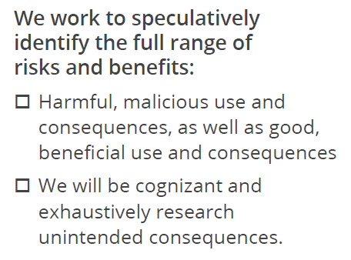
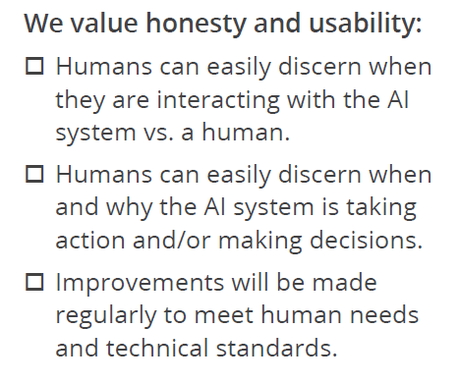
Prompts in checklists help reveal hidden tasks

Slide 21
UX Framework for Designing Trustworthy AI
Ethical AI
Accountable to humans
Cognizant of speculative risks and benefits
Respectful and secure
Honest and usable
Notes:
1) Accountable to humans
2) Cognizant of speculative risks and benefits
3) Respectful and secure
4) Honest and usable

Slide 22
RightStaff Scenario
AI shift scheduling system
Users: Store managers of fast food restaurants
Goals of RightStaff:
Faster staffing decisions and scheduling
Reduced bias of shift selection

Slide 23
Accountable to Humans
Ensure humans have ultimate control
Able to monitor and control risk
Human responsibility for final decisions
Person’s life
Quality of life
Health
Reputation
Ethical AI
Accountable to humans
Speculative
Respectful and secure
Honest and usable

Slide 24
“Ensure humans can unplug the machines”
– Grady Booch
TED Talk, Grady Booch, Scientist, Philosopher, IBM’er https://www.ted.com/talks/grady_booch_don_t_fear_superintelligence
Notes:
Secure back doors and brakes
“Ensure humans can unplug the machines” – Grady Booch, TED Talk
Grady Booch, Scientist, Philosopher, IBM’er https://www.ted.com/talks/grady_booch_don_t_fear_superintelligence

Slide 25
Significant decisions
Significant decisions made by the AI system will be
explained
able to be overridden
appealable and reversible
RightStaff
Manager able to reschedule people as needed

Slide 26
Responsibilities explicitly defined
Between AI system and human(s)
RightStaff (AI System or Manager?)
Picks employees to schedule?
Defines shifts?
Method to integrate new information?
Sick time
Resignations

Slide 27
Would we want RightStaff to turn off by itself, if noticed issues? Implications?

Slide 28
Cognizant of Speculative Risks and Benefits
Identify full range of
Harmful, malicious use, as well as good, beneficial use
Blind spots and unwanted/unintended consequences
Ethical AI
Accountable to humans
Speculative
Respectful and secure
Honest and usable

Slide 29
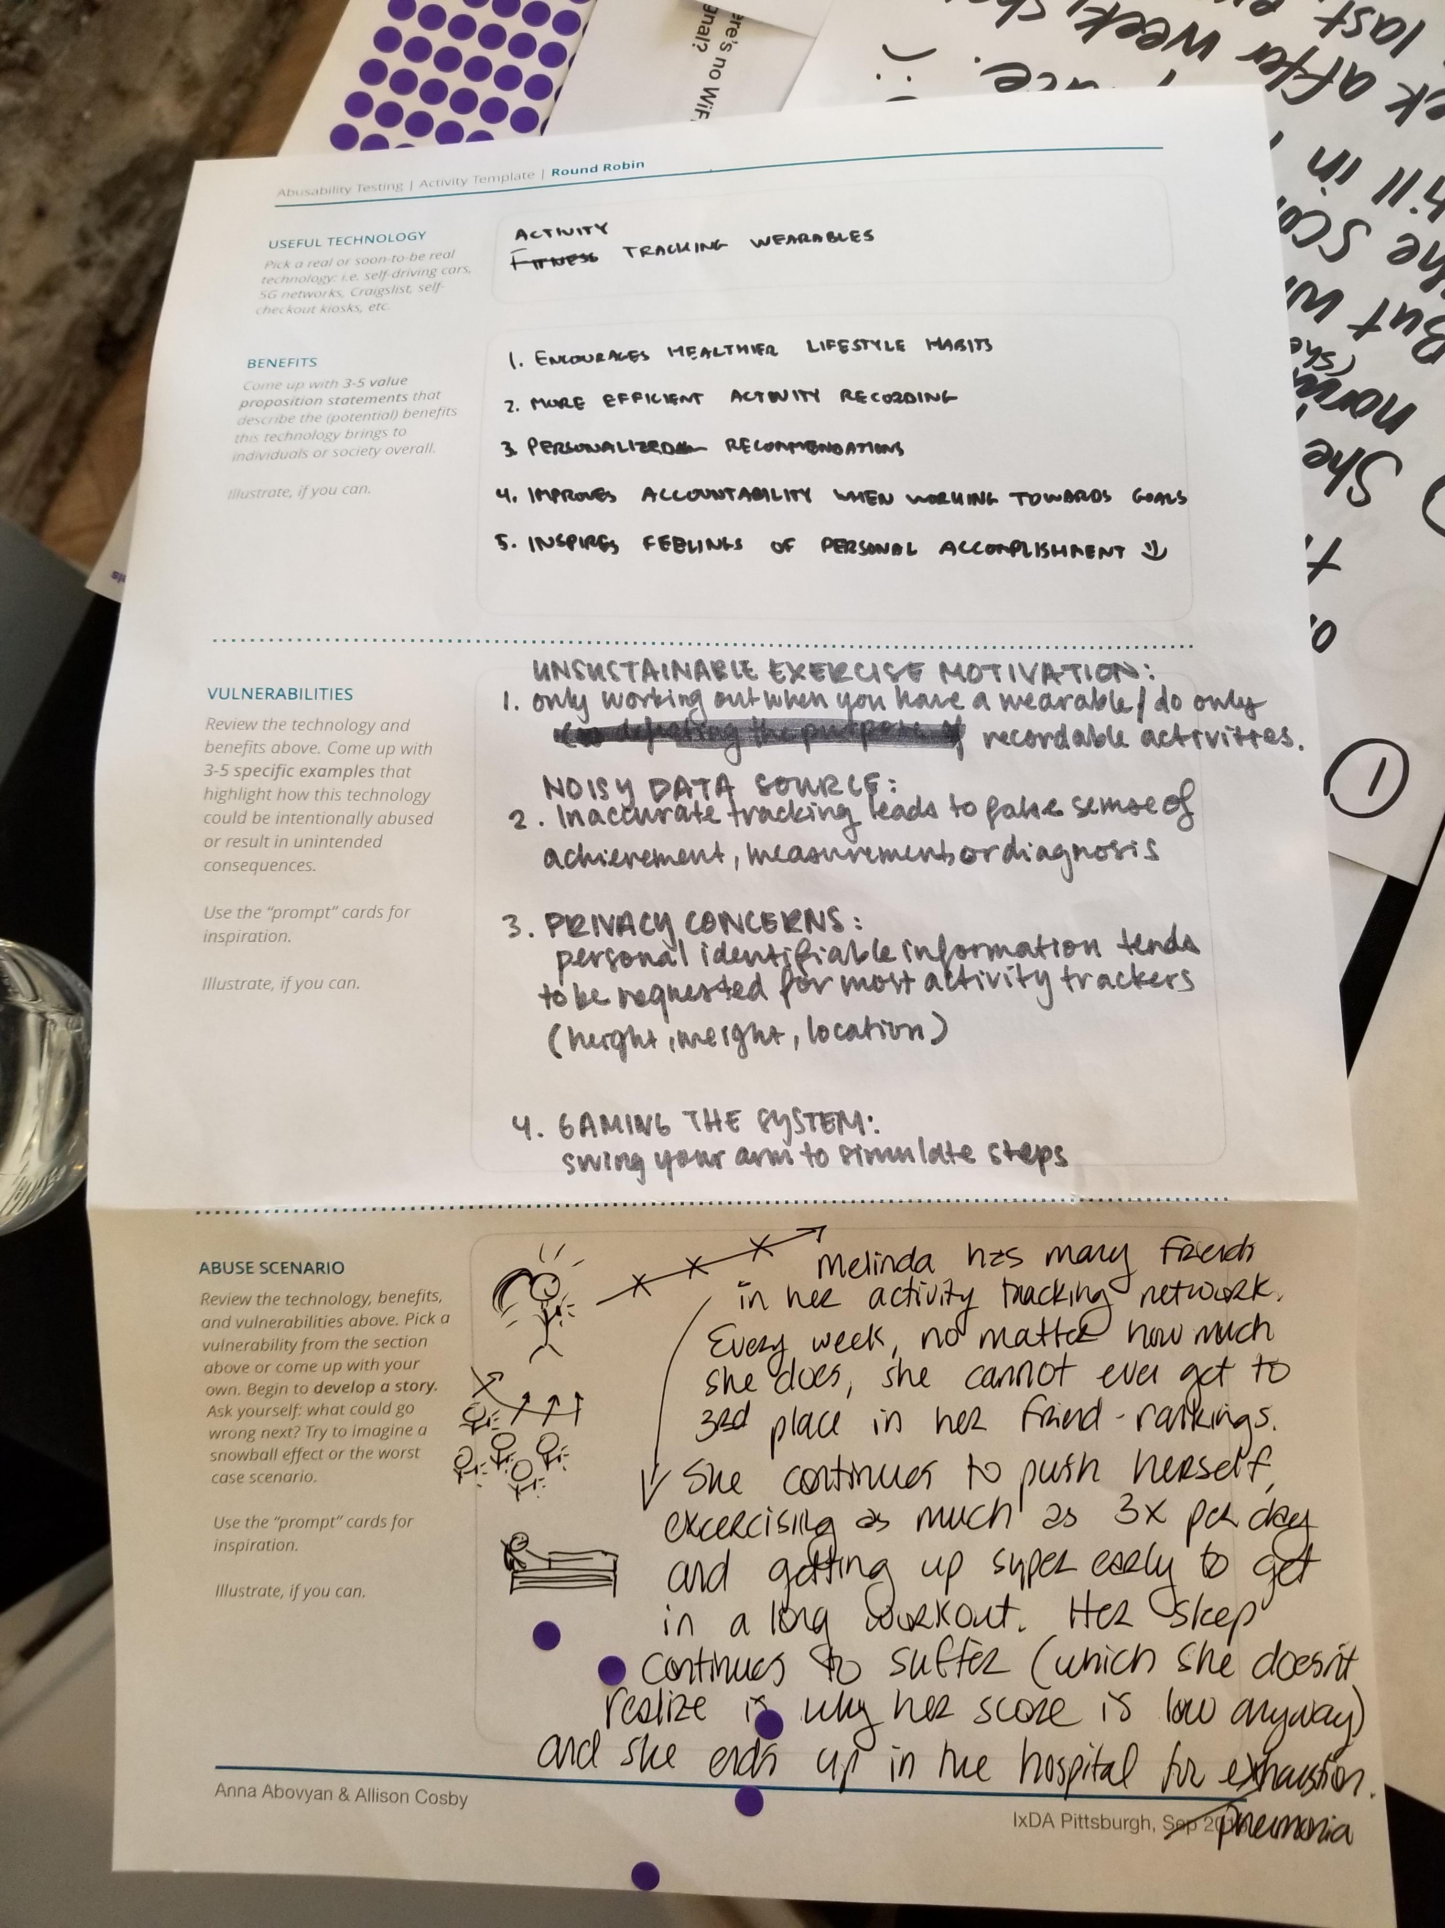
Speculative: Conduct UX research and activate curiosity
Abusability Testing
Speculate about misuse and abuse
Create “Black Mirror” episodes
Potential severe abuse and consequences
Template by: Anna Abovyan & Allison Cosby, IxDA Pittsburgh, Sep 2019
Notes:
Image of Template created by Anna Abovyan & Allison Cosby for Abusability Testing activity conducted at IxDA Pittsburgh, Sep 2019.
UX in the Age of Abusability. The role of Composition, Collaboration, and Craft in building ethical products.
Dan Brown. Sep 18, 2018. https://greenonions.com/ux-in-the-age-of-abusability-797cd01f6b13
Black Mirror, Light Mirror: Teaching Technology Ethics Through Speculation. Casey Fiesler. Oct 15, 2018.
https://howwegettonext.com/the-black-mirror-writers-room-teaching-technology-ethics-through-speculation-f1a9e2deccf4

Slide 30
Potential Abusability of RightStaff
RightStaff goals:
Faster staffing decisions and scheduling
Reduced bias of shift selection
Abusability of RightStaff:
System begins prioritizing people with easier schedules
Managers approve these schedules, reinforcing bias
People who were previously discriminated against are still discriminated against

Slide 31
Speculative: Create communication & mitigation plans
Plan for unwanted consequences
Misuse and abuse of AI system
Who can report?
To whom?
Turn off?
Who notified?
Consequences?
Notes:
Image: Google’s tensor processing units: https://www.nytimes.com/2018/02/12/technology/google-artificial-intelligence-chips.html

Slide 32
Respectful and Secure
Values of humanity, ethics, equity, fairness, accessibility, diversity and inclusion
Respect privacy and data rights
Make system robust, valid and reliable
Provide understandable security
Ethical AI
Accountable to humans
Speculative
Respectful and secure
Honest and usable

Slide 33
Respectful and Secure
RightStaff
Who has visibility to reasons for changing schedules?
How is that information used?
How is PII* of employees protected?
*PII is Personally Identifiable Information (social security number, address, etc.)

Slide 34
Honest and Usable
Value transparency with the goal of engendering trust
Explicitly state identity as an AI system
Ethical AI
Accountable to humans
Speculative
Respectful and secure
Honest and usable

Slide 35
Fair: Remove unwanted bias in data
Show awareness of known and desirable bias
Acknowledge issues
Overcommunicate on issues
RightStaff
System built to reduce the known bias in existing data
Make it easy to report bias (or prevent it)

Slide 36
UX Framework: Being intentional, keeping people safe
Ethical AI
Accountable to humans
Cognizant of speculative risks and benefits
Respectful and secure
Honest and usable
Notes:
Monitor system
Identify warning signs
Use plain language
1) Accountable to humans
2) Cognizant of speculative risks and benefits
3) Respectful and secure
4) Honest and usable

Slide 37
We aren’t perfect, AI won’t be perfect
Diverse teams, inclusive environments
Adopt technical ethics
Encourage deep conversations (Checklist)
Activate curiosity; be speculative; imaginative
Ethical AI
Accountable to humans
Speculative
Respectful and secure
Honest and usable
Notes:
Diverse teams in inclusive environment
Shared set of technology ethics
Understand people’s needs and concerns for the system
Encourage deep conversations to align on clear expectations and mitigation plans
Use the HMT Framework’s Checklist and Agreement to design ethical AI experiences

Slide 38
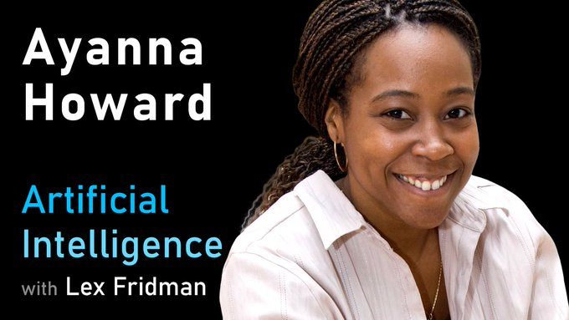
Reward team members for finding ethics bugs
Dr. Ayanna Howard - on the Artificial Intelligence Podcast with Lex Fridman
Notes:
Dr. Ayanna Howard: Human-Robot Interaction and Ethics of Safety-Critical Systems |
Artificial Intelligence Podcast with Lex Fridman
https://www.youtube.com/watch?v=J21-7AsUcgM
More about Dr. Ayanna Howard: https://howard.ece.gatech.edu/

Slide 39
Evangelize for human values Ethical. Transparent. Fair.
Notes:
Create AI systems that are accountable, de-risked, respectful, secure, honest, and usable

Slide 40
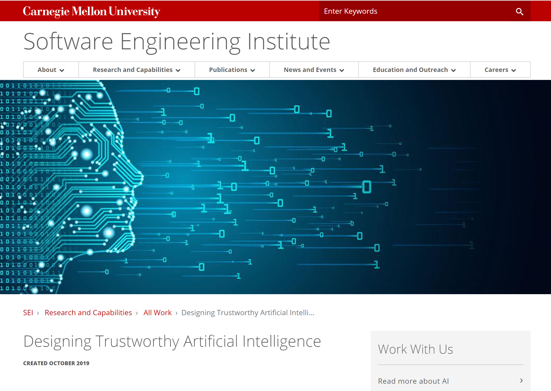
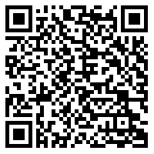
Learn More
SEI on HMT: https://sei.cmu.edu/research-capabilities/all-work/display.cfm?customel_datapageid_4050=197910
Notes:
SEI on HMT: https://sei.cmu.edu/research-capabilities/all-work/display.cfm?customel_datapageid_4050=197910
Software Engineering Institute > Designing Trustworthy Artificial Intelligence
https://sei.cmu.edu/research-capabilities/all-work/display.cfm?customel_datapageid_4050=197910

Slide 41
Carol J. Smith
cjsmith@sei.cmu.edu
Twitter: @carologic
SEI Emerging Technology Center
Twitter: @sei_etc

