Slide 1
Cyber Simulator Showcase CERT Cybersecurity Workforce Development Part 2 of 6: TopGen and Greybox
Gabriel Somlo 03 JUN 2019

Slide 2
Copyright 2019 Carnegie Mellon University. All Rights Reserved.
This material is based upon work funded and supported by the Department of Defense under Contract No. FA8702-15-D-0002 with Carnegie Mellon University for the operation of the Software Engineering Institute, a federally funded research and development center.
The view, opinions, and/or findings contained in this material are those of the author(s) and should not be construed as an official Government position, policy, or decision, unless designated by other documentation.
NO WARRANTY. THIS CARNEGIE MELLON UNIVERSITY AND SOFTWARE ENGINEERING INSTITUTE MATERIAL IS FURNISHED ON AN "AS-IS" BASIS. CARNEGIE MELLON UNIVERSITY MAKES NO WARRANTIES OF ANY KIND, EITHER EXPRESSED OR IMPLIED, AS TO ANY MATTER INCLUDING, BUT NOT LIMITED TO, WARRANTY OF FITNESS FOR PURPOSE OR MERCHANTABILITY, EXCLUSIVITY, OR RESULTS OBTAINED FROM USE OF THE MATERIAL. CARNEGIE MELLON UNIVERSITY DOES NOT MAKE ANY WARRANTY OF ANY KIND WITH RESPECT TO FREEDOM FROM PATENT, TRADEMARK, OR COPYRIGHT INFRINGEMENT.
[DISTRIBUTION STATEMENT A] This material has been approved for public release and unlimited distribution. Please see Copyright notice for non-US Government use and distribution.
This material may be reproduced in its entirety, without modification, and freely distributed in written or electronic form without requesting formal permission. Permission is required for any other use. Requests for permission should be directed to the Software Engineering Institute at permission@sei.cmu.edu.
Carnegie Mellon® and CERT® are registered in the U.S. Patent and Trademark Office by Carnegie Mellon University.
DM19-0578

Slide 3
TopGen and Greybox Internet Simulation Tools
Gabe Somlo 03 JUN 2019

Slide 4
TopGen / GreyBox Overview
Designed to bring Internet Services to ‘Air-Gapped’ networks
Application Virtualization
Portable and Extensible (1 VM)

Slide 5
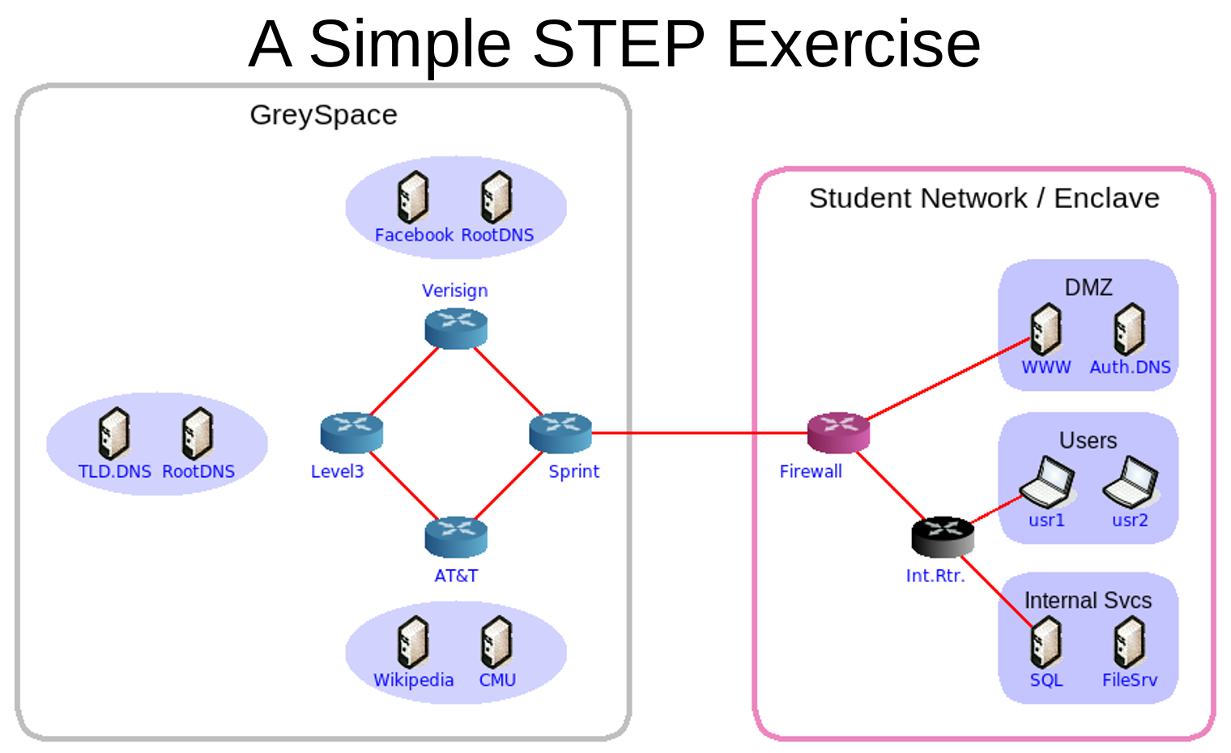

Slide 8
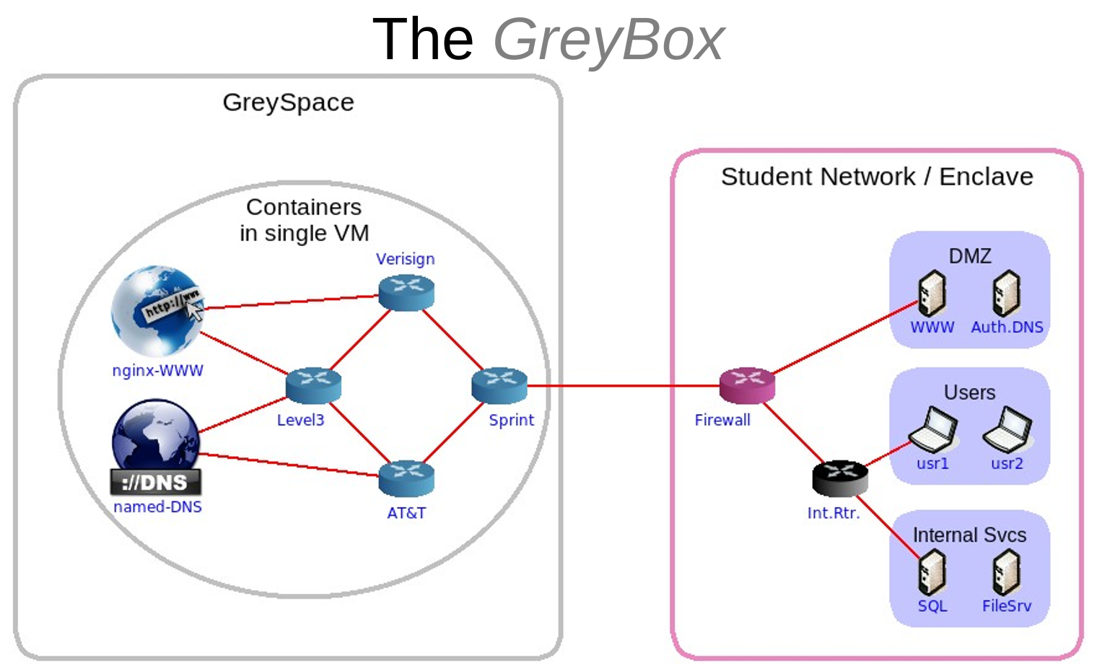

Slide 9
Questions ?

