Slide 1
Cyber Simulator Showcase
CERT Cybersecurity Workforce Development
Part 3 of 6: GHOSTS
Dustin Updyke
03 JUN 2019

Slide 2
Copyright 2019 Carnegie Mellon University. All Rights Reserved.
This material is based upon work funded and supported by the Department of Defense under Contract No. FA8702-15-D-0002 with Carnegie Mellon University for the operation of the Software Engineering Institute, a federally funded research and development center.
The view, opinions, and/or findings contained in this material are those of the author(s) and should not be construed as an official Government position, policy, or decision, unless designated by other documentation.
NO WARRANTY. THIS CARNEGIE MELLON UNIVERSITY AND SOFTWARE ENGINEERING INSTITUTE MATERIAL IS FURNISHED ON AN "AS-IS" BASIS. CARNEGIE MELLON UNIVERSITY MAKES NO WARRANTIES OF ANY KIND, EITHER EXPRESSED OR IMPLIED, AS TO ANY MATTER INCLUDING, BUT NOT LIMITED TO, WARRANTY OF FITNESS FOR PURPOSE OR MERCHANTABILITY, EXCLUSIVITY, OR RESULTS OBTAINED FROM USE OF THE MATERIAL. CARNEGIE MELLON UNIVERSITY DOES NOT MAKE ANY WARRANTY OF ANY KIND WITH RESPECT TO FREEDOM FROM PATENT, TRADEMARK, OR COPYRIGHT INFRINGEMENT.
[DISTRIBUTION STATEMENT A] This material has been approved for public release and unlimited distribution. Please see Copyright notice for non-US Government use and distribution.
This material may be reproduced in its entirety, without modification, and freely distributed in written or electronic form without requesting formal permission. Permission is required for any other use. Requests for permission should be directed to the Software Engineering Institute at permission@sei.cmu.edu.
Carnegie Mellon® and CERT® are registered in the U.S. Patent and Trademark Office by Carnegie Mellon University.
DM19-0578

Slide 3
GHOSTS in the Machine
Orchestrating a Realistic Cybersecurity Exercise Battlefield
Dustin Updyke
03 JUN 2019

Slide 4
Elite Teams Demand Realism (R-EACTR)
Roles
Tactics
Communication
Adversary
Environment
“
The strongest network defense teams require a credible challenge to get better. Without adversary simulation tools, you will quickly exhaust your ability to challenge these teams and keep up with their growth.
Raphael Mudge
(cobalt strike)
”

Slide 5
Exercise Adversaries & Scenarios

Slide 6
GHOSTS orchestrates realistic NPCs that:
Are behaviorally accurate, fully-autonomous
& represent an infinite array of possible interactions
(from harmless administrators to hostile nation-state attackers)
Match training realism with high training value
Prepare effective cyber warfare teams for
success in real-world situations

Slide 7
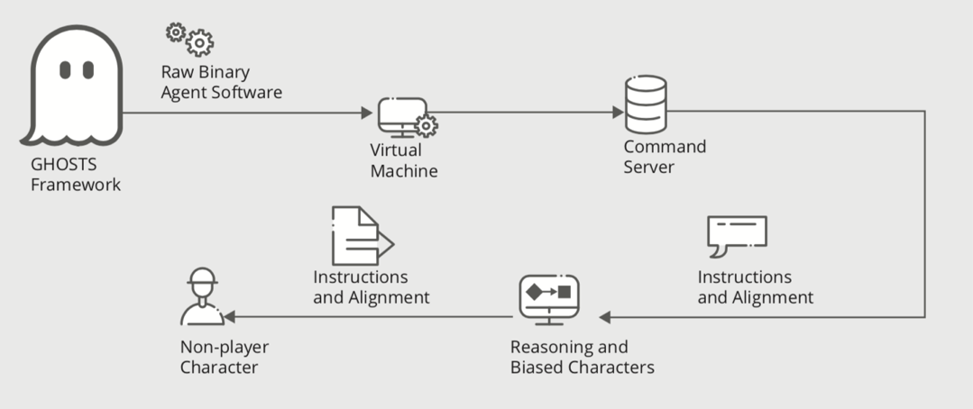
How GHOSTS Agents Work
  Client runs on Linux & Windows
  Learn from a command server by receiving instructions & alignment
  Gather info from other agents
  Reason & bias within a simulation as people would in real world

Slide 8



GHOSTS C2 (Out of Game via vTunnel)
OPFOR GHOST NPCs
OPFOR Players
Blue Team GHOSTS NPCs
“The Internet” via TopGen &
Neutral GHOSTS NPCs
Blue Team Players (DCO, etc.)
GreyBox

Slide 9




OPFOR GHOST NPCs
OPFOR Players
Blue Team GHOSTS NPCs
Neutral Internet GHOSTS NPCs
Blue Team Players (DCO, etc.)

Slide 10

GHOSTS NPC Orchestration
DEMO

Slide 11


Slide 12
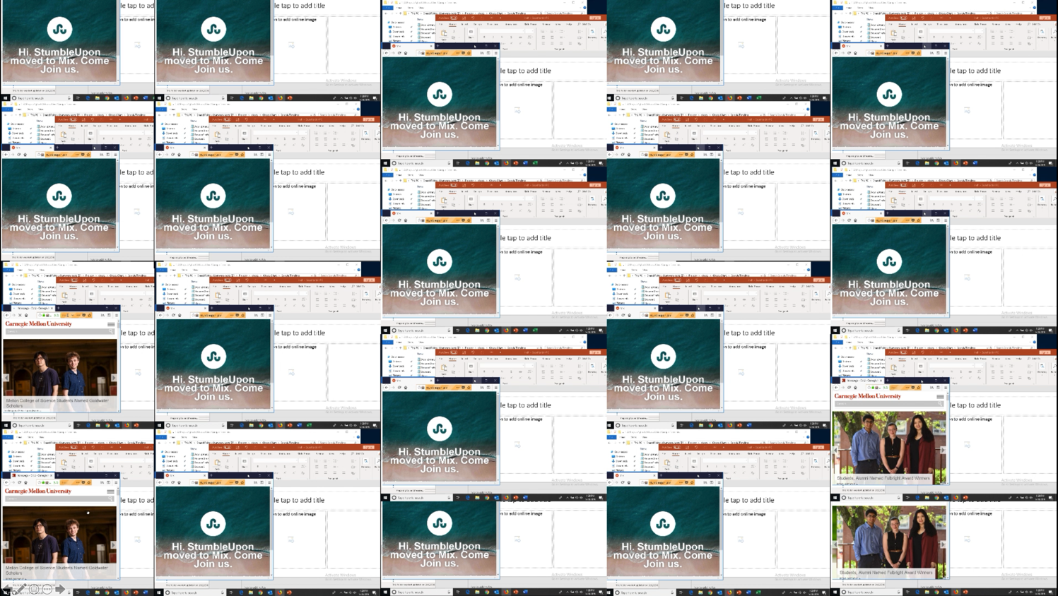
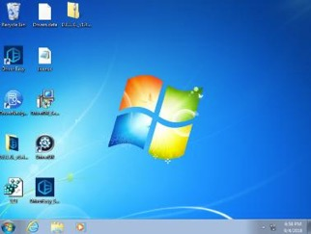
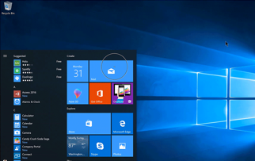
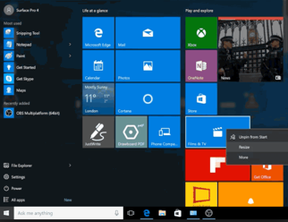

Slide 13
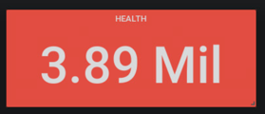
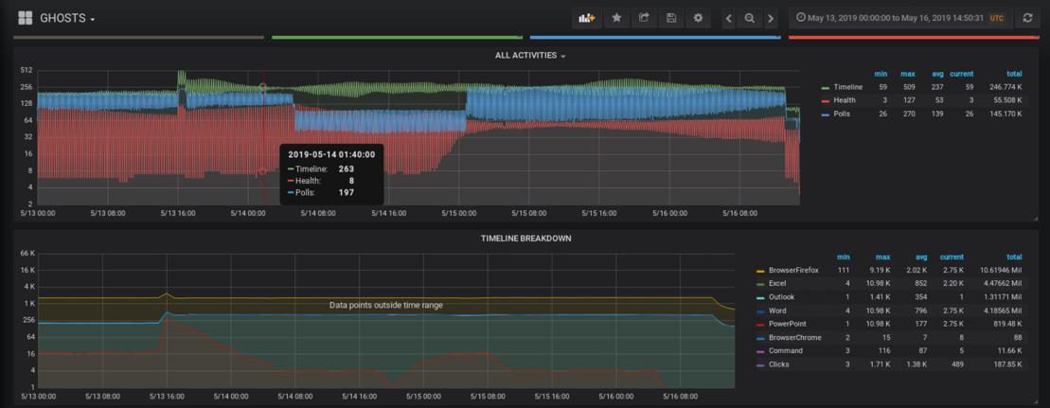

Slide 14
GHOSTS Product Roadmap
PHASE I – “basic plumbing”
Flexible/Configurable Client/Server communications
Basic reporting and tracking – server up/down, timeline progress, network overview
Systems engineers love it – easy to deploy, low resource impact, auto-manage
PHASE II - “formidable operator”
Realism/fidelity/randomization/entropy advancements
Blue team activity & response tracking
Improved health checks and activity reporting
Inject management & monitoring
PHASE III - “thinking adversary”
Opportunistic/responsive OPFOR, coordinated across terrain/assets/weaknesses
Opinionated – regarding individual/team responses/timing
Integrate and track player activity for full exercise insight
Extensive use of ML/AI techniques

Slide 15
Questions ?

