Slide 1
The Future of Cyber Simulation
Dr. Thomas Longstaff
Chief Technology Officer
Carnegie Mellon University Software Engineering Institute

Slide 2
Copyright 2019 Carnegie Mellon University. All Rights Reserved.
This material is based upon work funded and supported by the Department of Defense under Contract No. FA8702-15-D-0002 with Carnegie Mellon University for the operation of the Software Engineering Institute, a federally funded research and development center.
The view, opinions, and/or findings contained in this material are those of the author(s) and should not be construed as an official Government position, policy, or decision, unless designated by other documentation.
NO WARRANTY. THIS CARNEGIE MELLON UNIVERSITY AND SOFTWARE ENGINEERING INSTITUTE MATERIAL IS FURNISHED ON AN "AS-IS" BASIS. CARNEGIE MELLON UNIVERSITY MAKES NO WARRANTIES OF ANY KIND, EITHER EXPRESSED OR IMPLIED, AS TO ANY MATTER INCLUDING, BUT NOT LIMITED TO, WARRANTY OF FITNESS FOR PURPOSE OR MERCHANTABILITY, EXCLUSIVITY, OR RESULTS OBTAINED FROM USE OF THE MATERIAL. CARNEGIE MELLON UNIVERSITY DOES NOT MAKE ANY WARRANTY OF ANY KIND WITH RESPECT TO FREEDOM FROM PATENT, TRADEMARK, OR COPYRIGHT INFRINGEMENT.
[DISTRIBUTION STATEMENT A] This material has been approved for public release and unlimited distribution. Please see Copyright notice for non-US Government use and distribution.
This material may be reproduced in its entirety, without modification, and freely distributed in written or electronic form without requesting formal permission. Permission is required for any other use. Requests for permission should be directed to the Software Engineering Institute at permission@sei.cmu.edu.
Carnegie Mellon® is registered in the U.S. Patent and Trademark Office by Carnegie Mellon University.
DM19-0556

Slide 3
Today, the threat of cyber-attack on our critical infrastructure continues to grow.
[imagery: possible threats]

Slide 4
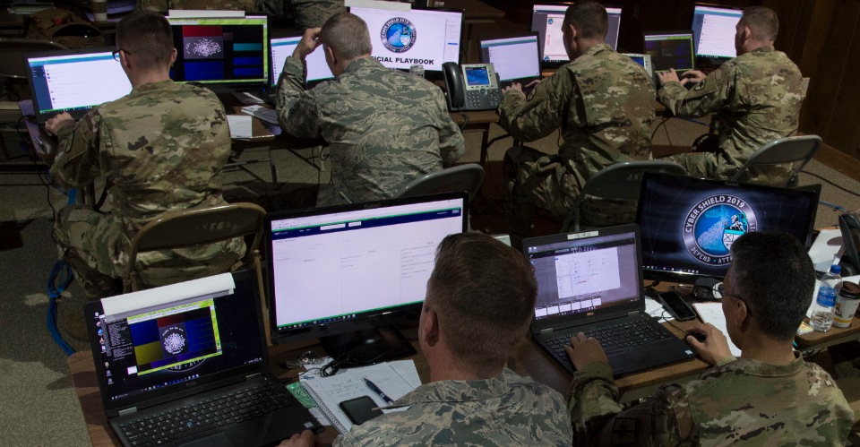
Relying on traditional cyber ranges and VTEs for preparation is no longer sufficient.

Slide 5
ML brings a new vision for preparation and training in cyber simulation.

Slide 6
The promise of ML-powered, data-driven cyber simulation platforms
immediate feedback
nearly limitless extensibility
higher fidelity
more rapid capability development

Slide 7
ML-enabled systems can be improved after deployment . . .
. . . because they can continue to learn from data generated by trainees and operators

Slide 8
ML systems are subject to cyber-attack.

Slide 9
The new vision blurs the line between simulation and reality.
Trained on 400 images
Trained on 1600 images

Slide 10
The new vision blurs the line between simulation and reality.

Slide 11
The new vision blurs the line between simulation and reality.

Slide 12
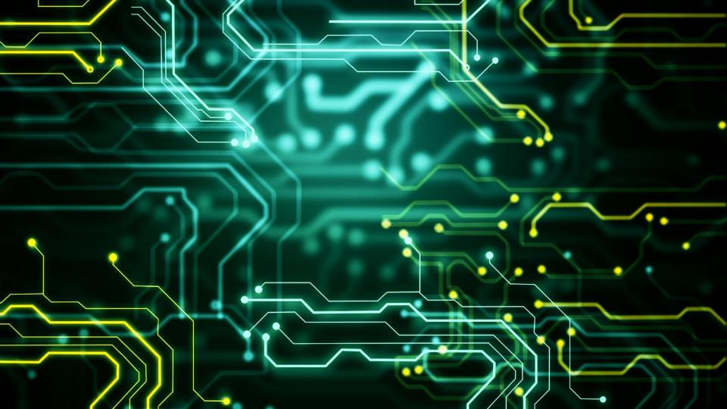
Using ML effectively, in cyber simulation and elsewhere, demands a robust discipline for AI engineering.
Science
Production
Professional Engineering
Commercial
Craft

Slide 13
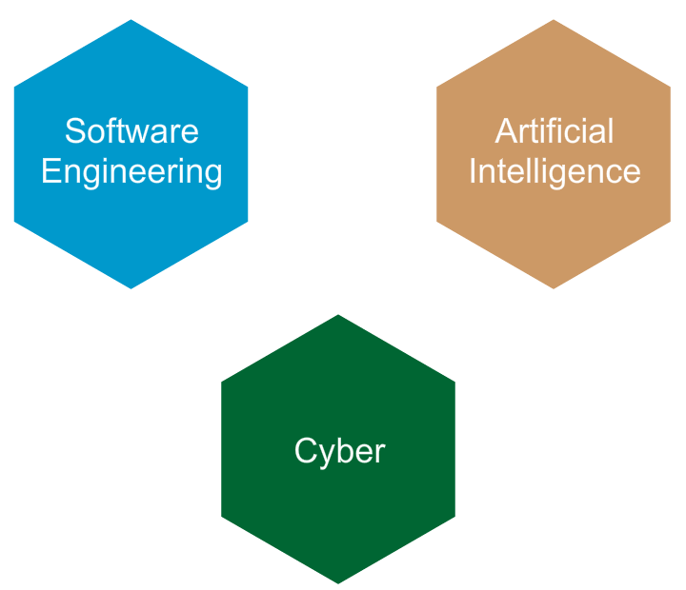
Building on SEI Strengths
Artificial Intelligence
… is built with…
Software
…is built on…
Data Science
…is enabled by…
Compute
Artificial Intelligence
… must be built…
Secure and Robust
…dramatically changes…
Attack Surface

