Slide 1
Overview
DD Month YYYY

Slide 2
Outline
The Smart Grid Maturity Model
SGMM community baseline as of August 2018
Learning more

Slide 3

A major power grid transformation is underway
How can utilities
  Develop effective roadmaps?
  Track progress?
  Understand their posture in comparison to peers?
The Smart Grid Maturity Model
was developed by utilities to
address these concerns

Slide 4

The Smart Grid Maturity Model is
A management tool
that provides a
common language and framework
for defining key elements of
smart grid transformation
and helping utilities develop a
programmatic approach
and track their progress

Slide 5
SGMM timeline
2007 |  | 2008 |  | 2009 |  | 2010 |  | 2011 |  | 2012 - 2016 |  | 2017 |  | 2018 |  | …
Global Intelligent Utility Network Coalition (GIUNC) develops SGMM
Utilities use SGMM v1.0
v1.1
v1.2
SGMM
public release
Software Engineering Institute becomes model steward
SGMM Open Assess-ment
Event
GIUNC:
CenterPoint Energy
Progress Energy
DONG Energy
North Delhi Power Ltd
Country Energy
Sempra Energy
Pepco Holdings
IBM
APQC
SEI releases
SGMM v1.1 product suite
Licensing & certification program for SGMM Navigation begins
SEI releases
SGMM v1.2 product suite
Developed by utilities, for utilities

Slide 6


The Software Engineering Institute
The SEI is a federally-funded research and development center at Carnegie Mellon University, a global university recognized worldwide for its energy and environmental research initiatives.
A trusted, objective source of best practices, methods and tools to organizations worldwide, the SEI is a global leader in software and systems engineering, process improvement and security best practices – all critical elements of smart grid success.
The SEI collaborates in public-private partnership with government and industry on important cyber security, architecture, and interoperability challenges of the smart grid.

Slide 7


The SEI’s role as steward of the SGMM
Provided governance working with multiple stakeholders
Enabled widespread availability, adoption,
and use of the model for the benefit of the community
Evolved the model based on stakeholder needs, market developments, user feedback, and interactions with domain experts
Developed transition mechanisms—education, training, awareness, research collaboration—to support the model
Grew the SGMM community of users worldwide

Slide 8
SGMM at a glance
6 Maturity Levels: Defined sets of characteristics and outcomes
5
4
3
175 Characteristics: Features you would expect to see at each stage of the smart grid journey
2
1
0
SMR
Strategy, Management, & Regulatory
OS
Organization & Structure
GO
Grid Operations
WAM
Work & Asset Management
TECH
Technology
CUST
Customer
VCI
Value Chain Integration
SE
Societal & Environmental
8 Domains: Logical groupings of smart grid related characteristics

Slide 9
Smart Grid Maturity Model: levels
PIONEERING
Breaking new ground; industry-leading innovation
OPTIMIZING
Optimizing smart grid to benefit entire organization; may reach beyond organization; increased automation
INTEGRATING
Integrating smart grid deployments across the organization, realizing measurably improved performance
ENABLING
Investing based on clear strategy, implementing first projects to enable smart grid (may be compartmentalized)
INITIATING
Taking the first steps, exploring options, conducting experiments, developing smart grid vision
DEFAULT
Default level (status quo)

Slide 10
Smart Grid Maturity Model: domains
SMR
Strategy, Mgmt & Regulatory
TECH
Technology
Vision, planning, governance, stakeholder collaboration
IT architecture, standards, infrastructure, integration, tools
OS
Organization and Structure
CUST
Customer
Culture, structure, training, communications, knowledge mgmt
Pricing, customer participation & experience, advanced services
GO
Grid Operations
VCI
Value Chain Integration
Reliability, efficiency, security, safety, observability, control
Demand & supply management, leveraging market opportunities
WAM
Work & Asset Management
SE
Societal & Environmental
Asset monitoring, tracking & maintenance, mobile workforce
Responsibility, sustainability, critical infrastructure, efficiency

Slide 11

Model | Fully described in the Model Definition document
Compass Survey | Questionnaire-based assessment yields maturity ratings and comparisons
Navigation Process | Defined process to complete Compass to build a common understanding and set aspirations across the organization
V 1.2 Product Suite
To download the SGMM product suite, go to
https://resources.sei.cmu.edu/library/asset-view.cfm?assetid=512758

Slide 12
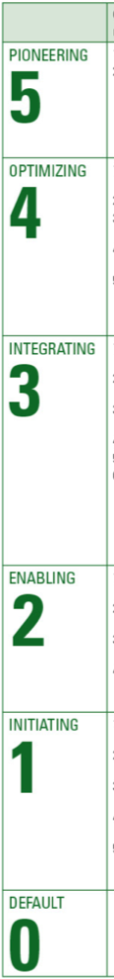
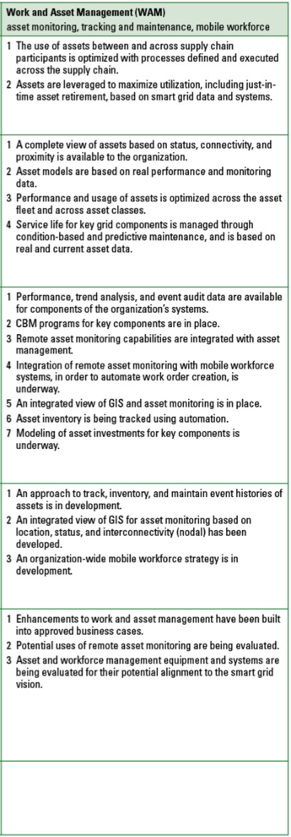
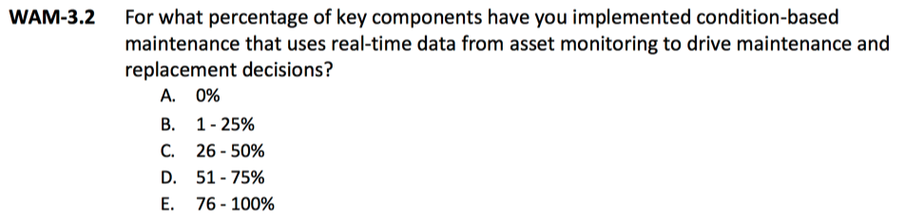
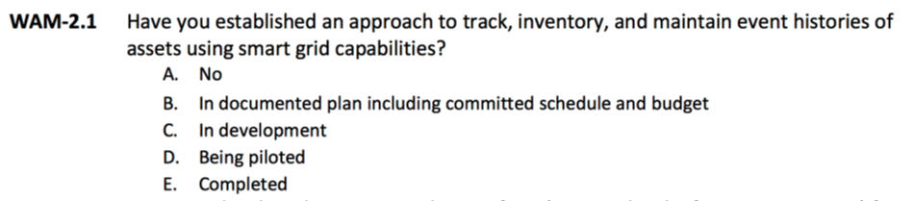
SGMM Compass Survey
WAM
Work and Asset
Management
Contains
  One question for each expected characteristic in the model and
  Attribute and performance questions
Example questions:
WAM-3.2 Condition-based maintenance programs for key components are in place.
WAM-2.1 An approach to track, inventory, and maintain event histories of assets is in development.

Slide 13





SGMM Navigation: five-phase, expert-led process
Stakeholders complete SGMM Compass survey
Discussion and consensus answers lead to internal alignment on current state
Stakeholders review survey findings & set aspirational profile
Consensus on aspirational state and identification of motivations, actions, and obstacles to achieve it

Slide 14
Compass results: maturity profile example results
3
3
2
2
2
2
1
SGMM maturity profile includes a maturity score for each domain
0

Slide 15
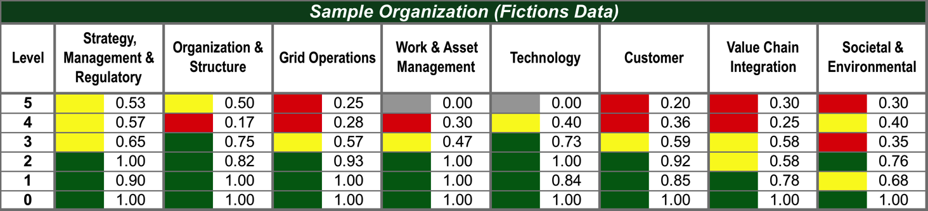
Compass results: dashboard example results
Sample Results
 | Point Range | Meaning
 | ≥ 0.70 | Green reflects level compliance within the domain
 | ≥ 0.40 and < 0.70 | Yellow reflects significant progress
 | < 0.40 | Red reflects initial progress
 | = 0 | Grey reflects has not started
Notes:
To achieve a maturity level, the organization must achieve all the previous maturity levels. In the dashboard above, the organization is Level 0 for SE since level 1 has not been achieved.

Slide 16
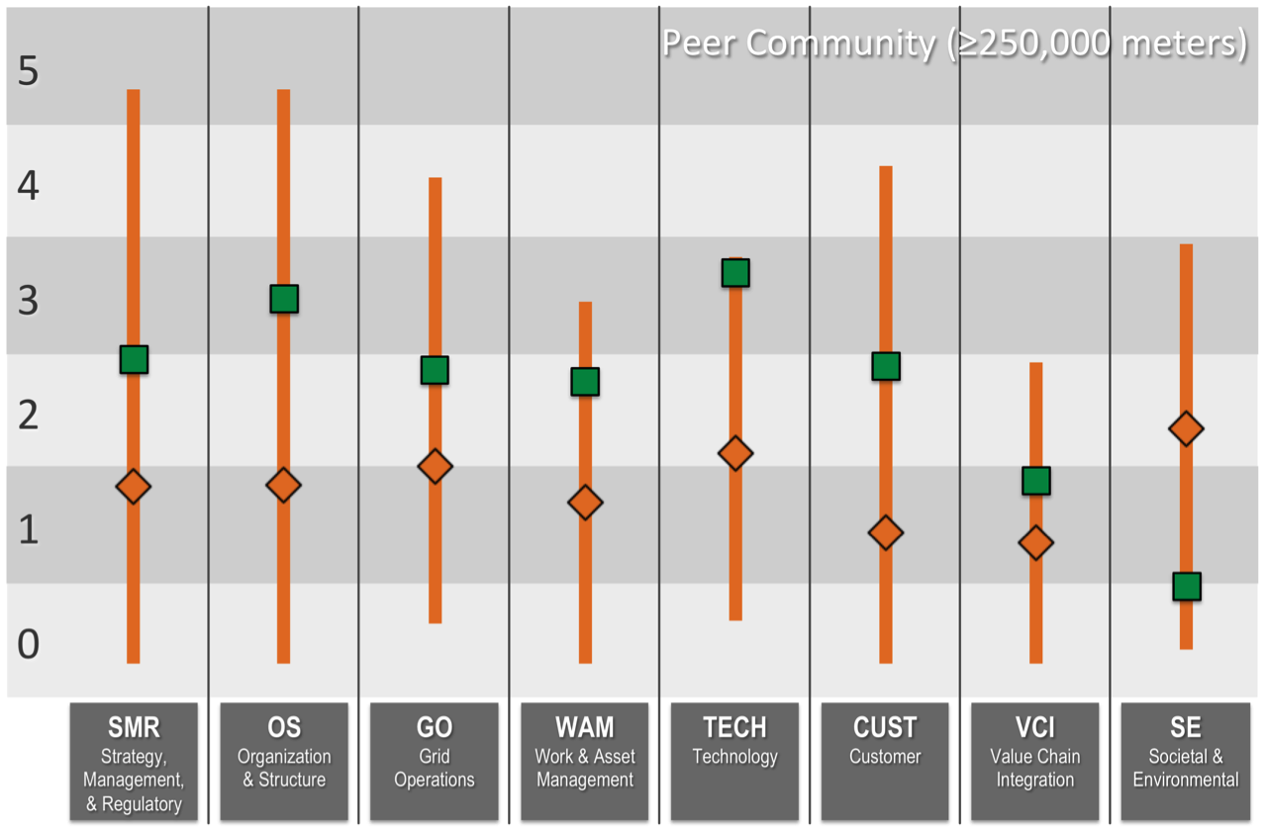
Compass results: peer community comparison example results
Orange bars are peer community ranges
Green squares are utility ratings
(example results)
Orange diamonds are peer community averages

Slide 17
Strategy, Mgmt, & Regulatory
Legend: Top 10-33% Bottom 33% Top 10% Red Italics Weakness against the model
5 |  | 5.3 New business model opportunities emerge as a result of smart grid capabilities and are implemented.
 |  | 5.2 Smart grid business activities provide sufficient financial resources to enable continued investment in smart grid sustainment and expansion.
 |  | 5.1 Smart grid strategy capitalizes on smart grid as a foundation for the introduction of new services and product offerings.
4 |  | 4.3 Smart grid strategy is shared and revised collaboratively with external stakeholders.
 |  | 4.2 Smart grid is a core competency throughout the organization.
 |  | 4.1 Smart grid vision and strategy drive the organization’s strategy and direction.
3 |  | 3.4 Required authorizations for smart grid investments have been secured.
 |  | 3.3 Smart grid leaders with explicit authority across functions and lines of business are designated to ensure effective implementation of the smart grid strategy.
 |  | 3.2 A smart grid governance model is established.
 |  | 3.1 The smart grid vision, strategy, and business case are incorporated into the vision and strategy.
2 |  | 2.6 There is support and funding for conducting proof-of-concept projects to evaluate feasibility and alignment.
 |  | 2.5 There is collaboration with regulators and other stakeholders regarding implementation of the smart grid vision and strategy.
 |  | 2.4 Budgets are established specifically for funding the implementation of the smart grid vision.
 |  | 2.3 Operational investment is explicitly aligned to the smart grid strategy.
 |  | 2.2 A common smart grid vision is accepted across the organization.
 |  | 2.1 An initial smart grid strategy and a business plan are approved by management.
1 |  | 1.3 Discussions have been held with regulators about the organization’s smart grid vision.
 |  | 1.2 Experimental implementations of smart grid concepts are supported.
 |  | 1.1 Smart grid vision is developed with a goal of operational improvement.
Example results
Fictitious organization
Aspiration setting:
Model characteristics are sequentially reviewed, discussed, and considered for levels that have not yet been achieved.
Consensus on relevance and importance to organization for achieving characteristics is used to set aspiration.

Slide 18
Strategy, Mgmt, & Regulatory
Aspiration Setting Tool
Example results
Fictitious organization
5
4
3
2
1
0
What motivates this aspiration?
What actions must happen to achieve this aspiration?
What obstacles must be overcome to achieve this aspiration?
Aspiration
Current

Slide 19
Navigation results: consensus aspirations example results
This is where we aspire to be in X years
4
4
4
3
3
3
3
3
2
2
2
2
2
2
This is where we are today
1
NOTE: There is no “correct” target profile implied in the model; the optimal profile will vary by utility.
0

Slide 20

SGMM community baseline: 384 utilities in 47 countries
=1
=5
20

Slide 21
SGMM community baseline: 384 utilities in 47 countries
13 Australia
2 Bahrain
10 Bangladesh
2 Belgium
4 Brazil
26 Canada
3 China
1 Colombia
8 Costa Rica
2 Denmark
1 Ecuador
3 Finland
1 France
2 Hong Kong
57 India
2 Indonesia
1 Ireland
2 Israel
1 Jamaica
1 Japan
1 Kuwait
1 Malaysia
6 Mexico
1 Myanmar
1 Nepal
2 Netherlands
8 New Zealand
4 Nigeria
7 Oman
1 Pakistan
1 Panama
3 Philippines
1 Poland
1 Russia
6 Saudi Arabia
1 Scotland
1 Singapore
8 South Africa
1 South Korea
1 Spain
17 Sweden
1 Switzerland
10 United Arab Emirates
7 United Kingdom
133 United States
1 Vietnam
1 Zimbabwe
Other
13%
USA
36%
Asia-
Pacific
29%
Europe, Middle East, and Africa
22%

Slide 22

Utilities in SGMM community baseline
37 U.S. States
9 Canadian Provinces
Abu-Sultan Thermal Power Plant
Abuja Electricity Distribution Company
ActewAGL
Adani Transmission Ltd. Ahmedabad
AES Electropaulo
Ajmer Vidyut Vitran Nigam Ltd.
Alameda Municipal Power
Alectra Utilities Corporation
Alfanar Construction Saudi Arabia
Allegheny Power
Alliander
Alliant Energy Corporation
AltaLink
Ameren Illinois
Ameren Missouri
American Electric Power
Andhra Pradesh Gas Power Company Ltd.
Andhra Pradesh Power Generation Corp. Ltd.
APCPDCL
Arkansas Electric Cooperatives, INC
ASAB Zero Substation (GASCO – Power Generation Units at Habshan
AtA
Atchison-Holt Electric Cooperative
ATCO Electric
ATCO Gas
Atlantica Yield plc
Aurora Energy
Ausgrid
Ausnet
Austin Energy
Avantha Power & Infrastructure Ltd.
AZUSA Light and Water
Bangladesh Power Development Board
Bangladesh Rural Electrification Board
Baraka Power Ltd.
Barapukuria Power Station
Basin Electric Power Cooperative
Bayfield Electric Cooperative
BC Hydro
BESCOM
Bhutan Power Corp. Ltd.
Bonneville Power Admin.
Boone Electric Cooperative
Bruce Power L.P.
BSES Yamuna Power Ltd.
BSES- Rajdhani
Burbank Water and Power
Calcutta Electric Cooperative Corp.
Capital Power Corporation
Carroll Electric Cooperative Corp.
Carteret-Craven Electric Cooperative
Cauvery Power Generation Chennai Pvt Ltd.
Cegelec Saudi Co. MNC
CELPE
CENACE
CenterPoint Energy
Central Maine Power Company
Centro Sur
CESC Limited
CESC Mysore
47 Countries

Slide 23
Utilities in SGMM community baseline (cont.)
CFE (Mexico) Gulfonorte
CFE (Mexico) Jalisco
CFE (Mexico) Peninsular
CFE Distribution
CFE Transmission
Chelan County PUD
Chettinad Corp. Ltd. – Power Division
Chhattisgarh State Power Distribution Company Ltd.
Chugach Electric
CitiPower and Powercor Australia Ltd.
City of Anaheim
City Of Columbus
City Of Danville
City Of Dover
City of Ekurhuleni (Energy)
City Of Hamilton
City Of Hudson
City Of Jackson
City Of Napoleon
City Of Painesville
City Of Palo Alto
City Of Piqua Power System
City of Riverside Public Utilities
City of Tshwane
City Of Wapakoneta
City Of Westerville
City Power Johannesburg (SOC) Ltd.
Cleco Power
CLP Power
Cogentrix Energy Power Management LLC
Coldwater Board Of Public Utilities
Columbus Southern Power Company
Comisión Federal de Electricidad- Corprativo
Compañía Nacional de Fuerza y Luz, S.A.
Connexus Energy
COOPEALFARORUIZ R.L
Coopeguanacaste R.L.
COOPELESCA RL
COOPESANTOS, R.L.
Corn Belt Energy
Coserv Electric
Cotton Electric Cooperative Inc.
Country Energy
CPFL Paulista
Dairyland Power Cooperative
Damodar Valley Corp.
Davao Light and Power Company
Desh Energy Ltd.
Dhofar Power Company S.A.O.C.
DNH Power Distribution Corp. Ltd.
Dominion Virginia Power
DONG Energy Sales & Distribution A/S
DPA Power Generation International Ltd.
Dr Narla Tata Rao (Vijayawada) TPS
Drax Power
DTE Energy
Dubai Electricity and Water Authority
DUBAL Power Plant
Duke Energy
Eandis
Eandis cvba
East Kentucky Power Cooperative, Inc.
Dr Narla Tata Rao (Vijayawada) TPS
Drax Power
DTE Energy
Dubai Electricity and Water Authority
DUBAL Power Plant
Duke Energy
Eandis
Eandis cvba
East Kentucky Power Cooperative, Inc.
East Miss EPA
EDF Energy Networks Branch
EDP - Energias do Brasil, S.A.
Eggborough Power Ltd.
Electricity and Water Authority of Bahrain (Transmission Division)
Ellevio AB
Emera Maine
Empresa de Servicios Públicos de Heredia
Empresas Públicas de Medellin, Centro de Excelencia Técnica
Energinet
EnergyAustralia
EnergyPac Power Generation Ltd.
EnergyUnited Electric Membership Corp.
Enexis
ENSA
Entergy
EPCOR Distribution & Transmission
Ephrata Borough
ERDF
Ergon Energy
ESB Networks
Eskom Holdings SOC Ltd.
Essar Power Transmission Company Ltd.
Essel Utilities Distribution Company Ltd.
eThekwini Municipality, Electricity Unit
Everest Power Generation Company Ltd.
Eversource Energy
Exelon/ComEd
Exelon/PECO Energy
Fingrid Oyj

Slide 24
Utilities in SGMM community baseline (cont.)
Fingrid Oyj
First Electric Cooperative
FirstEnergy
Fortum
Foster Wheeler
Garland Power & Light
GASCO – Power Generation Units at Habshan
Genesis Energy
Glendale Water & Power
Göteborg Energi Nät AB
Great Lakes Energy
Great River Energy
Guandong Power Co.
Guernsey Electricity
Gujarat Energy Transmission Corp. Ltd.
Hajar Trading and Technical services WLL (Transmission Division)
Hallstaviks Elverk
HAWK Power Generation
Hidd Power Company
Hindalco Industries Ltd.
Holland Board of Public Works
Horizon Power
Hydro One
Hydro One - Distribution
Hydro Ottawa Ltd.
Hydro-Québec Distribution
ICE (Instituto Costarricense de Electricidad)
IEC
Imperial Irrigation District
Infigen Energy
Integral Energy
Intergys
Intermountain Rural Electric Association
Israel Electric Corporation
IVRCL
Jamaica Public Service Company
JASEC
Jindal India Thermal Power Ltd.
Jos Electricity distribution PLC
Kalpataru Power Transmission Ltd.
Kamo Electric Cooperative, Inc.
Karlskoga Elnät AB
Kathmandu Alternative Power and Energy Group (KAPEG)
KaXu Solar One
Kelvin Power Station
Kentucky Utilities Company Inc.
KEPCO
Kerala State Electricity Board Ltd.
Kissimmee Utility Authority
Köyliön-Säkylän Sähkö Oy
Kristinehamns Elnät AB
L&T Power
Lahore Electric Supply Company
Lamma Coal Power Station
London Hydro Inc.
Los Angeles Department of Water and Power
M.P. Power Transmission Co. Ltd.
Maharashtra Electricity Regulatory Commission
Maharashtra State Electricity Distribution Co. Ltd.
Majan Electricity Company S.A.O.C.
Mälarenergi Elnät AB
Mangalore Electricity Supply
Manila Electric Company
Manitoba Hydro - T&D
Maquoketa Valley Rural Electric Cooperative
Marietta Board of Lights and Water
Marquette Board of Light & Power
Mazoon Electricity Company
Mellersta Skånes Kraft
Memphis Light, Gas, and Water Division
Meridian Energy
Minnkota Power Cooperative Inc.
Mjölby Kraftnät AB
Mogale City Electricity
MSEDCL
Msunduzi Electricity Sub-Unit
Muscat Electricity Distribution Company S.A.O.C
Muscatine Power & Water
PHE J&K Sub Division I
PNM
Pohjolan Voima Oy
Port-Burnett Electric Cooperative
Port-Harcourt Electricity Distribution Co.
Portland General Electric
Power & Water Utility Company for Jubail & Yanbu
Powerco
PowerGrid Corporation of India
PPL Electric Utilities
Princeton Electric Plant Board
Progress Energy
PSEG Power LLC.
PT. International Power Mitsui
PT. Jawa power
Public Utility District 1 of Clark County
Puget Sound
Quilliq Energy Corp.
Rabigh Arabian Water & Electricity Company
REC Power Distribution Co. Ltd.
Redding

Slide 25
Utilities in SGMM community baseline (cont.)
Reliance Energy
Reliance Infrastructure Ltd.
Reliance Power Transmission Ltd.
Rihand Super Thermal power
Roseville Electric
Rural Areas Electricity Co.
SA Power Network
Sabiya CCGT Power Plant
Sacramento Municipal Utility District
Salt River Project
Sand Mountain Electric Cooperative
Sandhult-Sandareds Elektriska
Santee Cooper
SaskPower
Saudi Electricity Company (SEC) National Grid
SCANA
Scottish Power
SDG&E
Sevab Nat AB
Shams Solar Power Station
SIG Geneva
Silicon Valley Power
SJVN Ltd.
SMEPC - International Cooperation Dept.
Snohomish
Snohomish County Public Utility District (PUD)
Södra Hallands Kraft Ekonomisk Fören
South Central Power Co.
South River Electric Membership Corporation
South Texas Electric Cooperative Inc.
Southern Company
Southern Electricity Supply Company of Orissa Ltd.
Southern Maryland Electric Cooperative
Southwestern Public Services Co.
SSE PLC
Sterlite Power Transmission Ltd.
Summit Power Ltd.
Talen Energy Corporation
Tamil Nadu Electricity Board
Tampa Electric Company
TAQA
TasNetworks Pty Ltd.
Tata Power
Te Mihi Power Station
Tenaga Nasionale Berhad
The Middle Tennessee Electric Membership Corporation
The United Illuminating Co.
Tihama Power Generation Co.
Tokyo Electric Power Co.
Top Energy
Toronto Hydro Electric System Ltd.
Torrent Power Ltd.
Town Of Front Royal
Toyo-Thai Corp. Public Co. Ltd.
TransAlta Renewables
Tri-State Generation and Transmission Association Inc.
TTPMC
Tuas Power Generation
Tucson Electric Power
UGVCL
Umeå Energi AB
Unidaan FZ LLC, Aljouf Cement Company (O&M Site)
Unión Fenosa Distribución
Unison Networks Ltd.
United Power Inc.
UNS Electric
Vara Energi Ek.
Varbergortens Elkraft
Vattenfall Distribution
Vattenfall INC.
Vattenfall Wind Power Ltd
Vector Ltd.
VELCO
Venture Energy Resources Ltd.
Vietnam Electricity
Village Of Carey, Ohio
Village Of Clinton
Village Of Oak Harbor
Village Of Yellow Springs
Visayan Electric Company Inc.
Wadi Al Jazzi Power Co.
Wadsworth Electric And Communications
West Bengal State Electricity Transmission Co.
Westar Energy Inc.
Western Electricity Supply Company of Orissa Ltd.
Western Power Distribution
Wind World (India) Ltd.
Wyandotte Municipal Service
Xcel Energy
Yantarenergo
Yola Electricity Distribution Co.
ZADCO – Upper Zakum Project
Zhejiang Jiaxing Electric Power Bureau
Zimbabwe Power Company

Slide 26
SGMM benefits: a community view
Use of SGMM by utilities
Utilities
Guidance, common language, & means to track progress
SGMM Partners
Product to help customers and participation in roadmap development
DOE
Another mechanism to support grid modernization
SEI
Maturity &
Performance Data
“What works” patterns to inform strategies, services, & programs.
Correlations of performance to maturity patterns and other analyses
Demonstrations of the value of grid modernization.
Improvements to SGMM product suite.

Slide 27
Outline
The Smart Grid Maturity Model
SGMM community baseline as of August 2018
Learning more

Slide 28
SGMM community baseline: meter count
Largest: 40,194,371 Meters
Median: 1,000,000 Meters
250,000
Community segmentation breakpoint: 250,000 meters
Smallest: 40 Meters

Slide 29
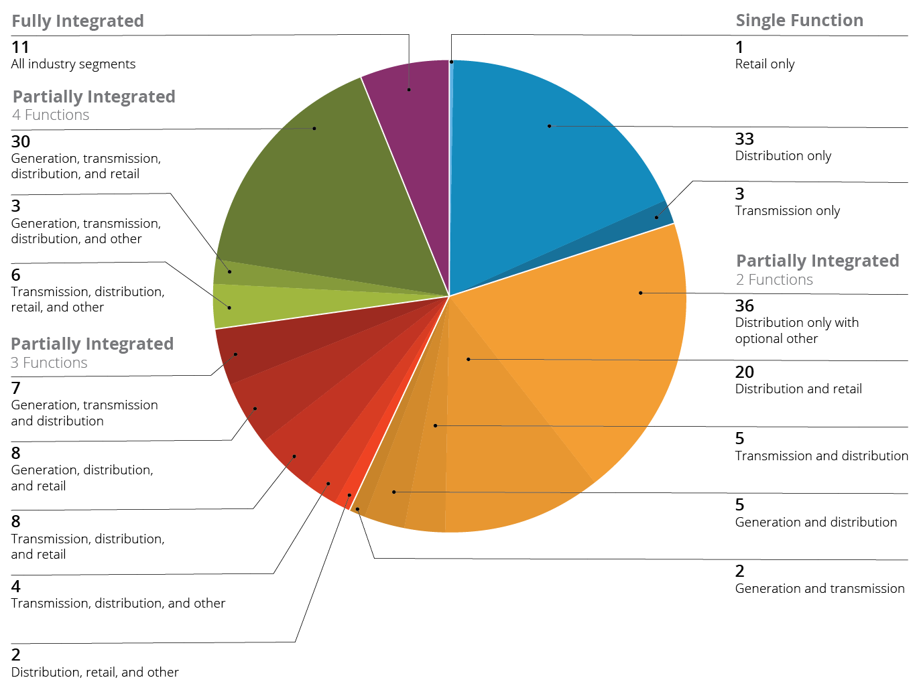
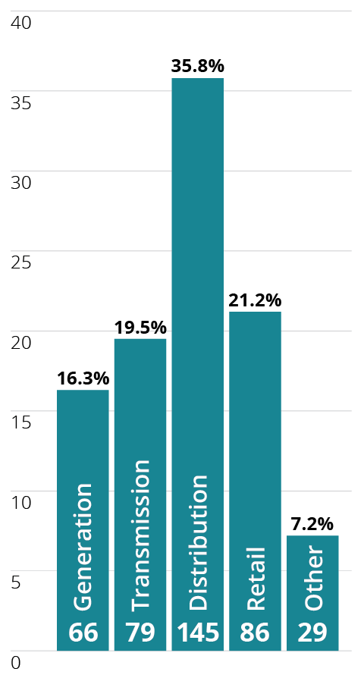
SGMM community baseline: utility type

Slide 30
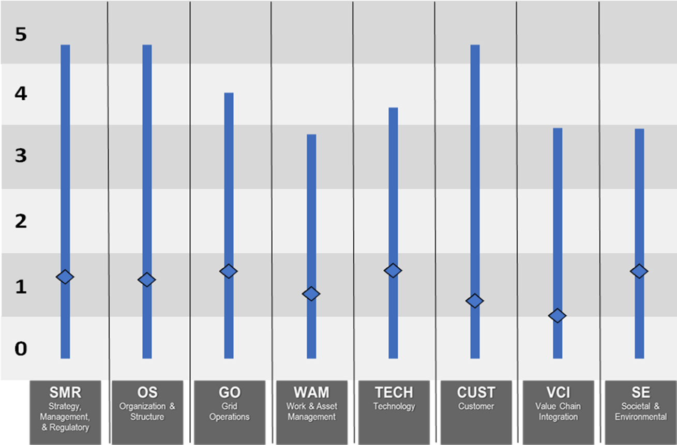
SGMM community baseline: all participants
Average and Range Maturity Scores

Slide 31
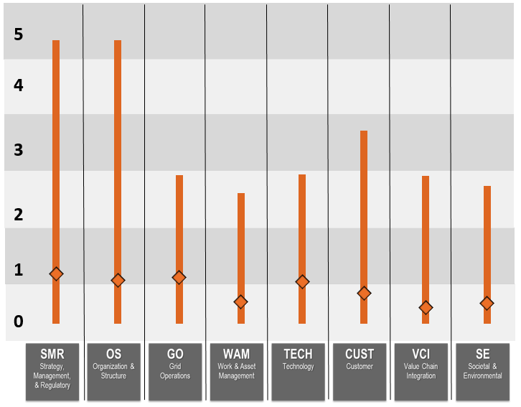
SGMM community baseline: < 250,000 meters
Average and Range Maturity Scores

Slide 32
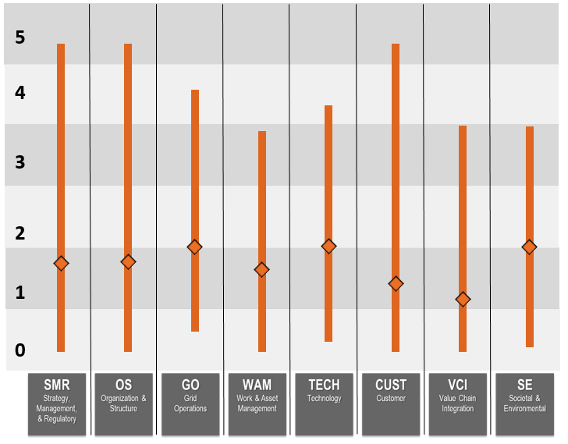
SGMM community baseline: ≥ 250,000 meters
Average and Range Maturity Scores

Slide 33
Outline
The Smart Grid Maturity Model
SGMM community baseline as of August 2018
Learning more

Slide 34
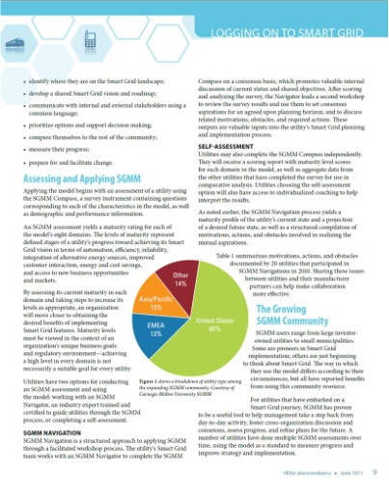

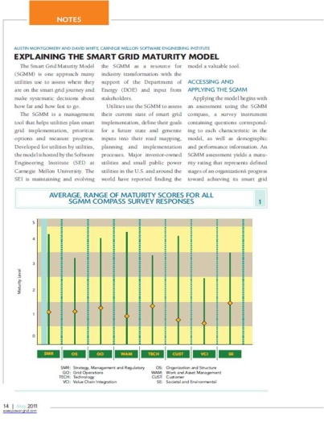




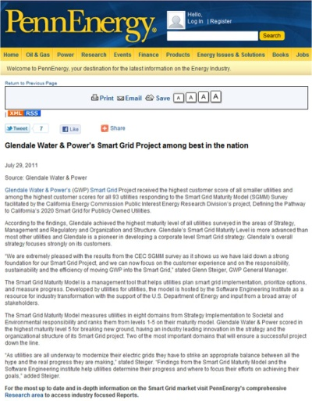

SGMM in the press

Slide 35



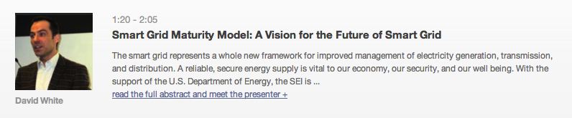
SGMM webinars
SGMM Around the World
SEI Webinar Series, May 15, 2014
https://resources.sei.cmu.edu/library/asset-view.cfm?assetid=303532
Empower Your Smart Grid Transformation SEI Webinar Series, March 10, 2011
https://resources.sei.cmu.edu/library/asset-view.cfm?assetid=21966
SEI Technologies Forum
October 20, 2011
https://resources.sei.cmu.edu/library/asset-view.cfm?assetid=21502
Notes:
Webinar: 519 registered; 180 joined live. 81 attendees filled out the follow-up survey. This webinar lead to a number of current SGMM partners.
Tech Forum:
729 registered for the event, 53 countries; 421 people participated live (at various times)
Webinar:
Attendees rated the value of the presentation a 3.6 /(out of) 5 (quite well considering the technical problem of losing final five minutes)
· 36% of those participating in the polls responding of first hearing about the SGMM from this webinar
· 5% of those participating in the polls responding of hearing about webinar from DistribuTECH
· When asked: “Are you interested in becoming an SEI-Certified SGMM Navigator?” 19 responded with “yes” and 25 responded with “maybe” (all on need_followup.xlsx)
Some sample comments when asked “Has this webinar caused you to take any actions? If so, what actions?”:
o Think about which UK clients of ours would be interested
o Follow up on becoming an SEI-Certified SGMM Navigator
o To dial back in... we were all cut off. Great stuff... but technology killed us
o Can I get a copy of the presentation? I would like to introduce SGMM to my organization
o We will start an internal initiative to get certified for this offering
o I could not complete the webinar due to technical difficulties with the host's computer. I am interested in learning more about Smart Grid initiatives through SEI and other sources
o Follow-up with my customer to see if they participated in the webinar.
o Review SGMM opportunities with colleagues

Slide 36






Partners were licensed to provide official SEI services, delivered by SEI-Certified SGMM Navigators, until the SGMM Partner and Navigator programs ended in mid-2018. At that time, the SGMM Partners were
SGMM Partners
Cognizant Technologies
To download the list of final Partners and Navigators, go to
https://resources.sei.cmu.edu/library/asset-view.cfm?assetID=524444

Slide 37

Plug in and get started with the SGMM.
Getting started
To download the SGMM product suite, go to
https://resources.sei.cmu.edu/library/asset-view.cfm?assetid=512758

Slide 38
Contact information
Presenter 1
Title
email@email.email
Phone
Presenter 2
Title
email@email.email
Phone
www.sei.cmu.edu/go/sgmm
www.apqc.org/smartgrid
info@sei.cmu.edu

Slide 39
Notices
Copyright 2018 Carnegie Mellon University. All rights reserved.
This material is based upon work funded and supported by the Department of Defense under Contract No. FA8721-05-C-0003 with Carnegie Mellon University for the operation of the Software Engineering Institute, a federally funded research and development center.
Any opinions, findings and conclusions or recommendations expressed in this material are those of the author(s) and do not necessarily reflect the views of the United States Department of Defense.
NO WARRANTY. THIS MATERIAL IS FURNISHED ON AN “AS-IS” BASIS WITH NO WARRANTIES OF ANY KIND, EITHER EXPRESSED OR IMPLIED, INCLUDING, BUT NOT LIMITED TO, WARRANTY OF FITNESS FOR PURPOSE OR MERCHANTABILITY, ANY WARRANTY WITH RESPECT TO FREEDOM FROM PATENT, TRADEMARK, OR COPYRIGHT INFRINGEMENT, OR THIRD PARTY INTELLECTUAL PROPERTY RIGHTS.
[Distribution Statement A] This material has been approved for public release and unlimited distribution. The United States Government has Unlimited Rights in this material as defined by DFARS 252.227-7013.
The text and illustrations in this material are licensed by Carnegie Mellon University under a Creative Commons Attribution 4.0 International License.
The Creative Commons license does not extend to logos, trade marks, or service marks of Carnegie Mellon University.

Slide 40
Color chart
Green
Utility as-is
R=4, G=129, B=60
Gold
Utility to-be
R=231, G=172, B=67
Blue
Full Community
R=64, G=108, B=187
Orange
Peer Community
R=222, G=102, B=33

