Slide 1
Hands-On Tutorial:
Auditing Static Analysis Alerts Using a Lexicon & Rules
Lori Flynn, David Svoboda, William Snavely
Notes:
At the beginning, skip to the Virtual Machine Setup, so that people set up their VMs during intro.

Slide 2
Copyright 2017 Carnegie Mellon University. All Rights Reserved.
This material is based upon work funded and supported by the Department of Defense under Contract No. FA8702-15-D-0002 with Carnegie Mellon University for the operation of the Software Engineering Institute, a federally funded research and development center.
The view, opinions, and/or findings contained in this material are those of the author(s) and should not be construed as an official Government position, policy, or decision, unless designated by other documentation.
References herein to any specific commercial product, process, or service by trade name, trade mark, manufacturer, or otherwise, does not necessarily constitute or imply its endorsement, recommendation, or favoring by Carnegie Mellon University or its Software Engineering Institute.
NO WARRANTY. THIS CARNEGIE MELLON UNIVERSITY AND SOFTWARE ENGINEERING INSTITUTE MATERIAL IS FURNISHED ON AN "AS-IS" BASIS. CARNEGIE MELLON UNIVERSITY MAKES NO WARRANTIES OF ANY KIND, EITHER EXPRESSED OR IMPLIED, AS TO ANY MATTER INCLUDING, BUT NOT LIMITED TO, WARRANTY OF FITNESS FOR PURPOSE OR MERCHANTABILITY, EXCLUSIVITY, OR RESULTS OBTAINED FROM USE OF THE MATERIAL. CARNEGIE MELLON UNIVERSITY DOES NOT MAKE ANY WARRANTY OF ANY KIND WITH RESPECT TO FREEDOM FROM PATENT, TRADEMARK, OR COPYRIGHT INFRINGEMENT.
[DISTRIBUTION STATEMENT A] This material has been approved for public release and unlimited distribution. Please see Copyright notice for non-US Government use and distribution.
This material may be reproduced in its entirety, without modification, and freely distributed in written or electronic form without requesting formal permission. Permission is required for any other use. Requests for permission should be directed to the Software Engineering Institute at permission@sei.cmu.edu.
Carnegie Mellon® and CERT® are registered in the U.S. Patent and Trademark Office by Carnegie Mellon University.
DM17-0664

Slide 3
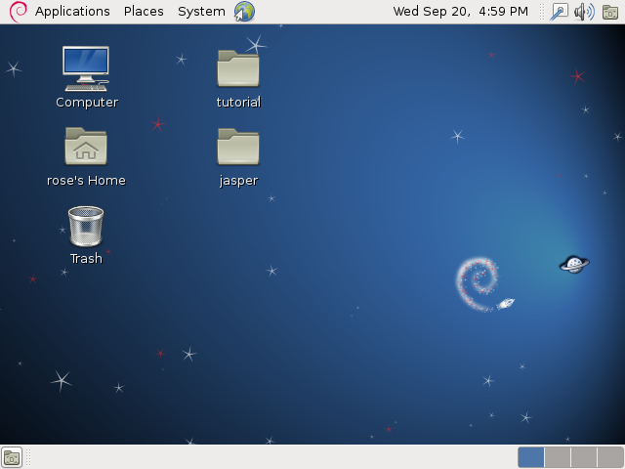
Virtual Machine Setup
Unpack tutorial bundle:
This should produce an .ovf file
Open VMWare Player and select File->Open
Select .ovf file
This will take about 5 minutes
to extract VM.
Boot VM: VM->Power->
Start up Guest
Dismiss any warning dialogs.
This will take 5 minutes
to boot to a Linux desktop.

Slide 4
Virtual Machine and Printouts
VM contains:
  Source code (JasPer plus example programs we developed)
  Static analysis tools: rosecheckers, cppcheck, GCC
  Static analysis tool output
Printouts
  Source code for example programs
  Relevant parts of static analysis tool output

Slide 5
Auditing Lexicon And Rules
  This tutorial covers a set of auditing rules and part of the lexicon we’ve developed.
  Lexicon contains a set of determinations for static analysis alerts
  Includes a set of auditing rules to help auditors make consistent decisions in commonly-encountered situations
  Different auditors should make the same determination for a given alert!
  Improve the quality and consistency of audit data for the purpose of building machine learning classifiers
  Help organizations make better-informed decisions about bug-fixes, development, and future audits.
Notes:
The result of this effort was a lexicon and an auditing rule set.
The lexicon contains well-defined determinations for static analysis alerts, and some other related terms. The rules are intended to help auditors make consistent decisions in a variety of commonly encountered situations.
The fundamental goal here is that different auditors should make the same determination for a given alert.
In the short term, we hoped this would improve the quality of the training data we were using to build our machine learning classifiers.
From a broader perspective, we believe that codified auditing terms and rules can help an organization make better decisions in various stages of their software development lifecycle, such as bug fixing, new development, and future audits.

Slide 6
This Tutorial
  Teach basics of static analysis alert auditing
  Clarify ambiguous or complex auditing scenarios
  Hands-on: make audit determinations on static analysis alerts and open-source code
  Learn how to make audit determinations more consistent
Focus on 12 rules
  Drew on our own experiences auditing code bases at CERT
  Trained groups of engineers on the rules, and incorporated their feedback
  Your feedback is welcome!

Slide 7
Lexicon: Audit Determinations
Dependent
Notes:
Our lexicon primarily defines a collection of auditing determinations for static analysis alerts. These determinations are broadly split into two categories: basic and supplementary.
Basic determinations are True, False, Complex, Dependent, and Unknown. Exactly one of these determinations can be applied to a given alert. We will give more precise definitions of these terms in the following slides.
The supplemental determinations capture other relevant features of an alert. Currently, this set consists of four determinations, Dangerous Construct, Dead, Ignore, and Inapplicable Environment, though this set is permitted to grow to include other determinations. Any number of supplemental determinations may be applied to an alert.

Slide 8
Lexicon: Basic Determinations
Unknown
  Nothing is known about the correctness of the alert.
True
  The code in question violates the condition indicated by the alert.
False
  The code in question does not violate the condition indicated by the alert.
  A condition is a constraint or property of validity.
    E.g. A valid program should not deference NULL pointers.
  The condition can be determined from the definition of the alert itself, or from the coding taxonomy the alert corresponds to.
    CERT Secure Coding Rules
    CWEs
Notes:
We’ll now give more detailed definitions of our terms, beginning with True.
For an alert to be marked true, the code in question must violate the condition indicated by the alert.
Here, a condition is defined as a constraint or property of validity, for example, A valid program should not dereference NULL pointers.
An alert’s condition can be determined by studying the documentation for the alert, or by referencing any secure coding guideline that the alert cites. For example, many alerts will refer to CERT Secure Coding Guidelines or CWEs.

Slide 9
Audit Rules
Assume external inputs to the program are malicious.
Some alerts are too difficult to judge; they should be marked Complex.
If an alert is true only when a previous alert is true, mark it Dependent.
Handle an alert in unreachable code depending on whether it is exportable.
An alert might indicate a true violation of the condition it is mapped to, even if the alert’s message is useless or incorrect.
Mark an alert True even if code maintainers will protest.
Unless instructed otherwise, assume code must be portable.
When auditing an alert, if a second true violation is discovered, its alert should be marked True.
Auditors must understand the language and the current alert’s condition.
Do not arbitrarily extend the scope of a condition.
Code that behaves as expected might still violate a condition.
Multiple messages help in understanding an alert.

Slide 10
JasPer
The JasPer Project is an open-source initiative to provide a free software-based reference implementation of the codec specified in the JPEG-2000 Part-1 standard (i.e., ISO/IEC 15444-1).
Some of our code examples come from this library.
It is designed to run on 32-bit Intel platforms.
This means we can rely on the sizes of various integer types.

Slide 11
Audit Rules
1. Assume external inputs to the program are malicious.

Slide 12
1. Assume external inputs to the program are malicious.
External inputs may be:
Arguments to a library function
Program arguments (argv in C)
Environment variables
External files (that aren’t bundled with the program)
Data over the network
User data

Slide 13
VM Exercise: Make an Alert Determination
Examine the diagnostic alert info at line 23 of the file tutorial/analysis/rosecheckers.txt
Examine the source code at line 24
of the file tutorial/src/file4.c
Examine CERT rule INT33-C in the
SEI Secure Coding Rules PDF,
on page 163.
Study for 2 minutes, then we’ll discuss.
Basic
Unknown
Unknown
Complex
True
False
Dependent
Supplemental
Dangerous
Ignored
Dead
Inapplicable

Slide 14
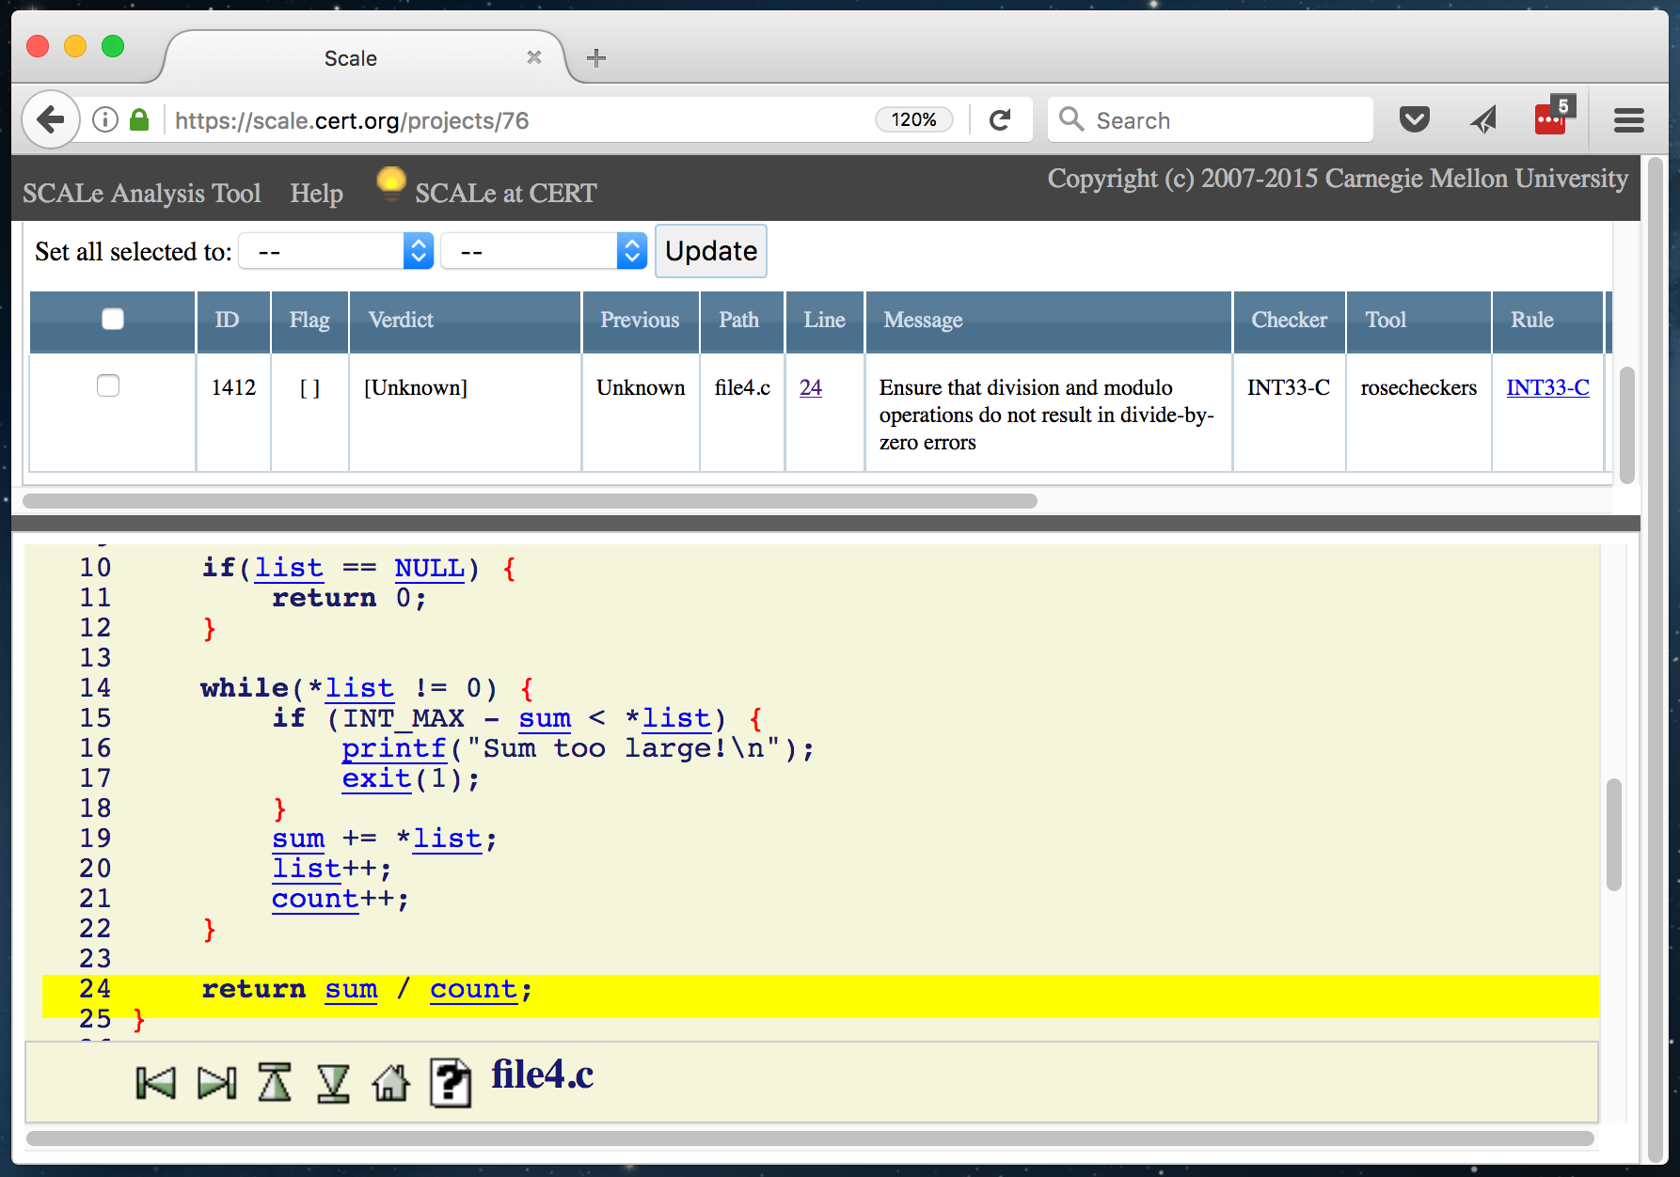
Example

Slide 15
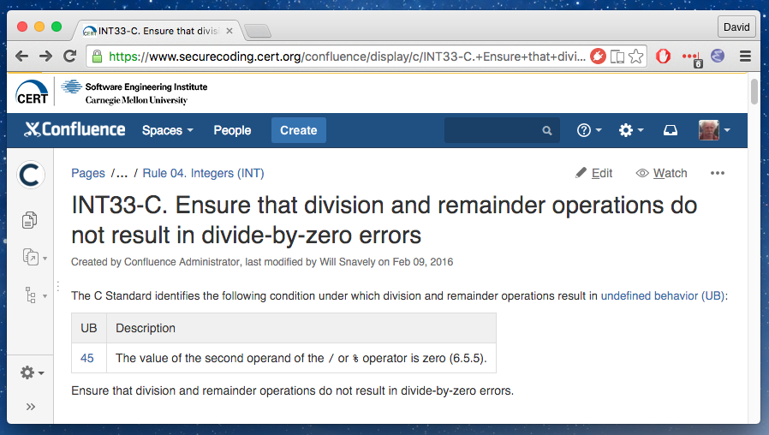
CERT Coding Rule INT33-C

Slide 16
Simple Code Example
int main(int argc, char **argv) {
int list[10];
int result;
for (int i = 0; i < 10; i++) {
if (i+1 >= argc) {
break;
}
read_integer(argv[i+1], &list[i]);
if (list[i] <= 0) {
break;
}
}
result = compute_int_average(list);
printf("Average is: %d\n", result);
return 0;
}
read_integer() fills 2nd arg with integer value of 1st arg.

Slide 17
The compute_int_average() function
int main(int argc, char **argv) {
int list[10];
int result;
for (int i = 0; i < 10; i++) {
if (i+1 >= argc) {
break;
}
read_integer(argv[i+1], &list[i]);
if (list[i] <= 0) {
break;
}
}
result = compute_int_average(list);
printf("Average is: %d\n", result);
return 0;
}
int compute_int_average(int* list) {
int sum = 0;
int count = 0;
if (list == NULL) {
return 0;
}
while (*list != 0) {
if (INT_MAX – sum > *list) {
printf(“Sum too large!\n”);
exit(1);
}
sum += *list;
list++;
count++;
}
return sum / count;
}

Slide 18
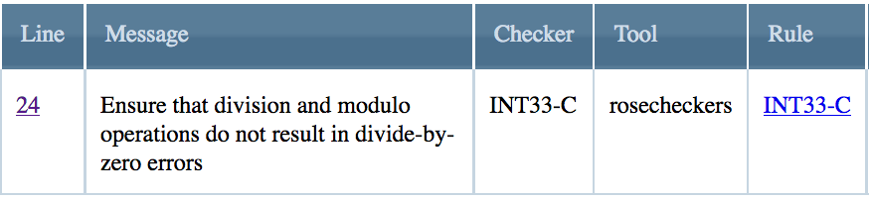
Alert to Audit
int main(int argc, char **argv) {
int list[10];
int result;
for (int i = 0; i < 10; i++) {
if (i+1 >= argc) {
break;
}
read_integer(argv[i+1], &list[i]);
if (list[i] <= 0) {
break;
}
}
result = compute_int_average(list);
printf("Average is: %d\n", result);
return 0;
}
int compute_int_average(int* list) {
int sum = 0;
int count = 0;
if (list == NULL) {
return 0;
}
while (*list != 0) {
if (INT_MAX – sum > *list) {
printf(“Sum too large!\n”);
exit(1);
}
sum += *list;
list++;
count++;
}
return sum / count;
}
What kind of input could cause this while loop to never execute?

Slide 19
Marking the alert
int main(int argc, char **argv) {
int list[10];
int result;
for (int i = 0; i < 10; i++) {
if (i+1 >= argc) {
break;
}
read_integer(argv[i+1], &list[i]);
if (list[i] == 0) {
break;
}
}
result = compute_int_average(list);
printf("Average is: %d\n", result);
return 0;
}
int compute_int_average(int* list) {
int sum = 0;
int count = 0;
if (list == NULL) {
return 0;
}
while (*list != 0) {
if (INT_MAX – sum > *list) {
printf(“Sum too large!\n”);
exit(1);
}
sum += *list;
list++;
count++;
}
return sum / count;
}
Unknown
Complex
False
Dependent
True

Slide 20
Audit Rules
2. Some alerts are too difficult to judge; they should be marked Complex.

Slide 21
2. Some alerts are too complex to judge; they should be marked Complex.
Auditors typically have many alerts to examine.
So don’t let a difficult alert slow you down.
Complex: The validity of the alert cannot be assessed given a reasonable amount of auditor effort.
Many of the other audit rules exist to reduce the number of alerts that must be marked Complex.
Notes:
After discussion we realized that SCALe should have a ‘complex’ verdict for these alerts.
The ‘suspicious’ verdict has a different meaning during a full audit; using it for complex alerts is only for the AFBs for the PV project.

Slide 22
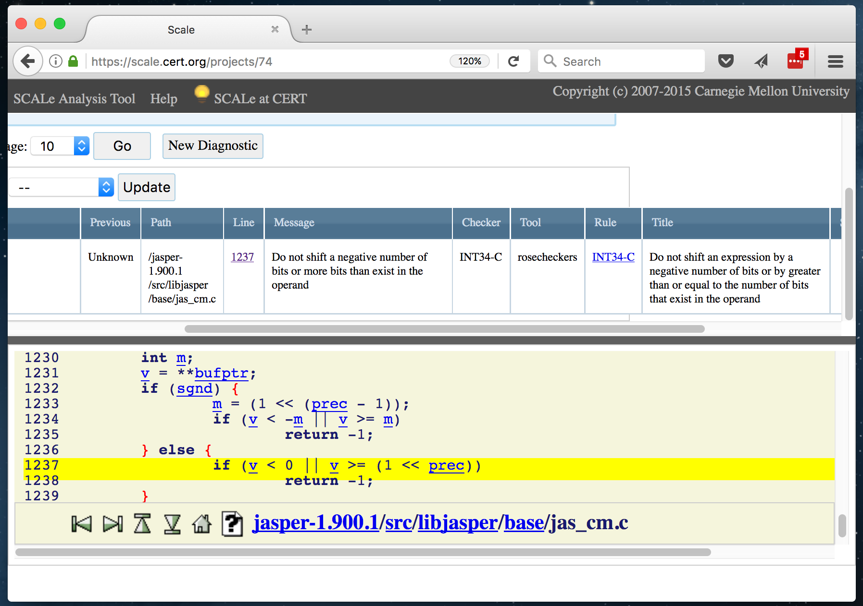
Example

Slide 23
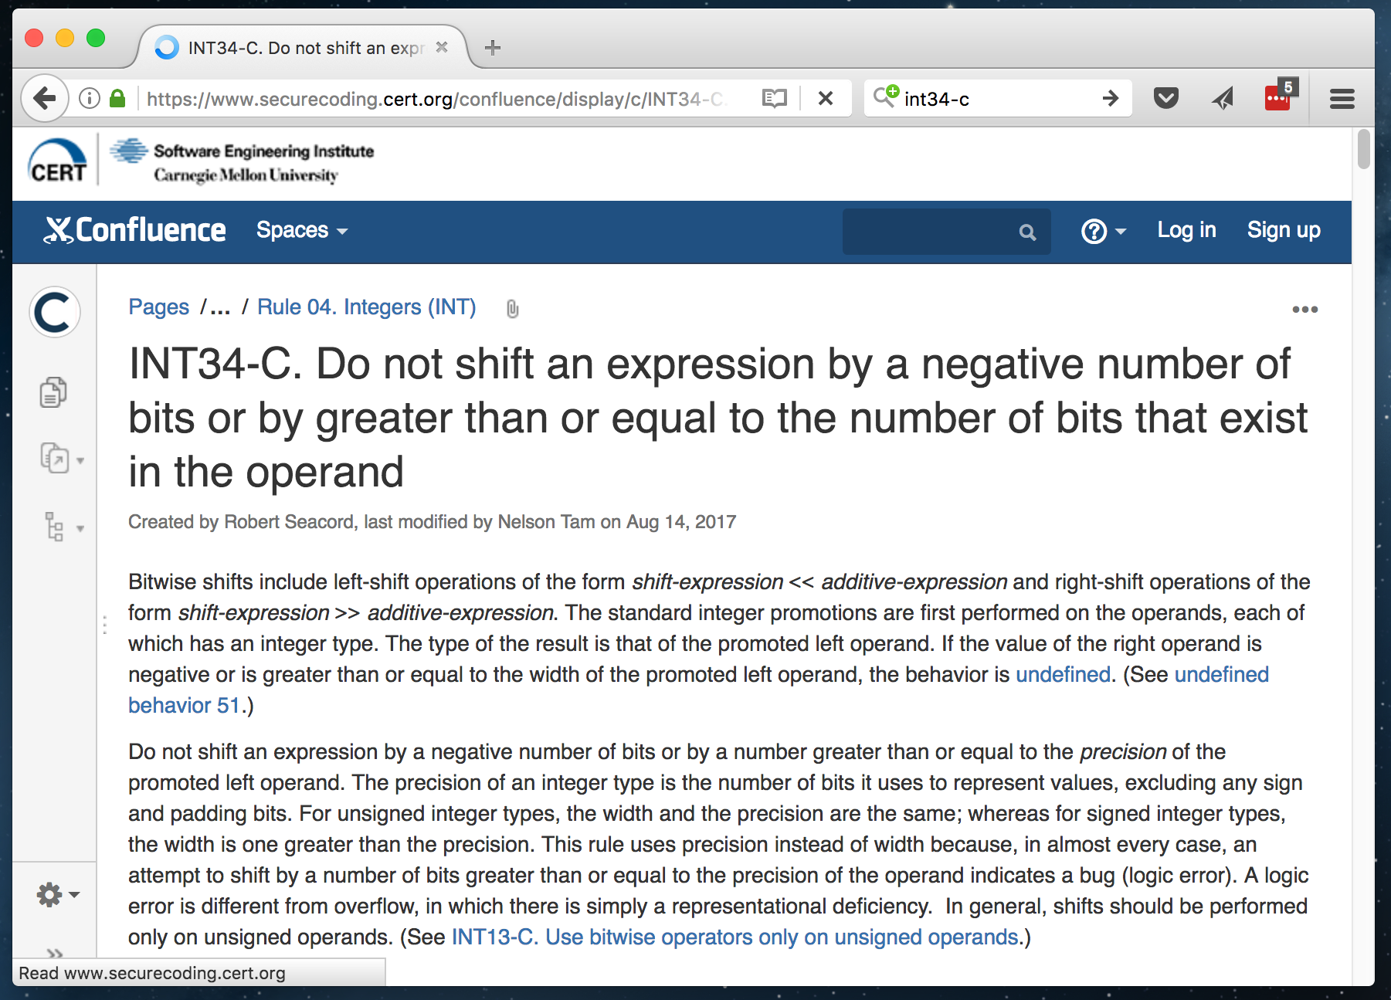
CERT Coding Rule INT34-C

Slide 24
Example
static int jas_cmgetint(long **bufptr, int sgnd,
int prec, long *val)
{
long v;
int m;
v = **bufptr;
if (sgnd) {
m = (1 << (prec - 1));
if (v < -m || v >= m)
return -1;
} else {
if (v < 0 || v >= (1 << prec))
return -1;
}
…

Slide 25
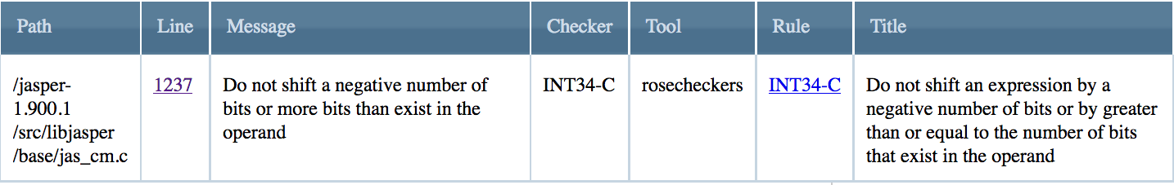
Alert to Audit
static int jas_cmgetint(long **bufptr, int sgnd,
int prec, long *val)
{
long v;
int m;
v = **bufptr;
if (sgnd) {
m = (1 << (prec - 1));
if (v < -m || v >= m)
return -1;
} else {
if (v < 0 || v >= (1 << prec))
return -1;
}
…
How big is prec?

Slide 26
Getting the size of prec
Determining how big prec is a complicated and time-consuming process, tracing back several function calls and data structures.
Consequently, an auditor can mark this alert Complex.

Slide 27
Marking the Alert
static int jas_cmgetint(long **bufptr, int sgnd,
int prec, long *val)
{
long v;
int m;
v = **bufptr;
if (sgnd) {
m = (1 << (prec - 1));
if (v < -m || v >= m)
return -1;
} else {
if (v < 0 || v >= (1 << prec))
return -1;
}
…
How big is prec?
Unknown
True
False
Dependent
Complex

Slide 28
Audit Rules
3. If an alert is true only when a previous alert is true, mark it Dependent.

Slide 29
3. If an alert is true only when a previous alert is true, mark it Dependent.
When code violates a secure coding condition, subsequent program behavior is hard to predict.
An auditor should begin with the assumption that the program is well-behaved before reaching the line in question.
  It does not matter whether unexpected behavior is possible, just that it does not happen.
Assuming that a program complies with secure coding conditions helps to minimize the difficulty of auditing code.

Slide 30
Earlier Violations
If an auditor is convinced that an alert might be true only if violation of a secure coding condition occurs earlier in the code:
Mark the alert as Dependent.
See Rule #8 for how to handle the earlier violation.
  8. When auditing an alert, if a second true violation is discovered, its alert should be marked True.
Dependent: The alert can only be valid if a secure coding condition was violated earlier in the code.

Slide 31
Weakness to Violations
An auditor might not be familiar with every secure coding condition, but if the code demonstrates undefined behavior or some other unexpected behavior, it is likely to violate a secure coding condition.

Slide 32
VM Exercise: Make an Alert Determination
Examine the diagnostic alert info at lines 28 and 30 of the file tutorial/analysis/rosecheckers.txt
Examine the source code at lines 24 and 27
of the file tutorial/src/file5.c
Examine CERT rule INT33-C in the
SEI Secure Coding Rules PDF,
on page 163.
Study for 2 minutes, then we’ll discuss.
Basic
Unknown
Unknown
Complex
True
False
Dependent
Supplemental
Dangerous
Ignored
Dead
Inapplicable

Slide 33
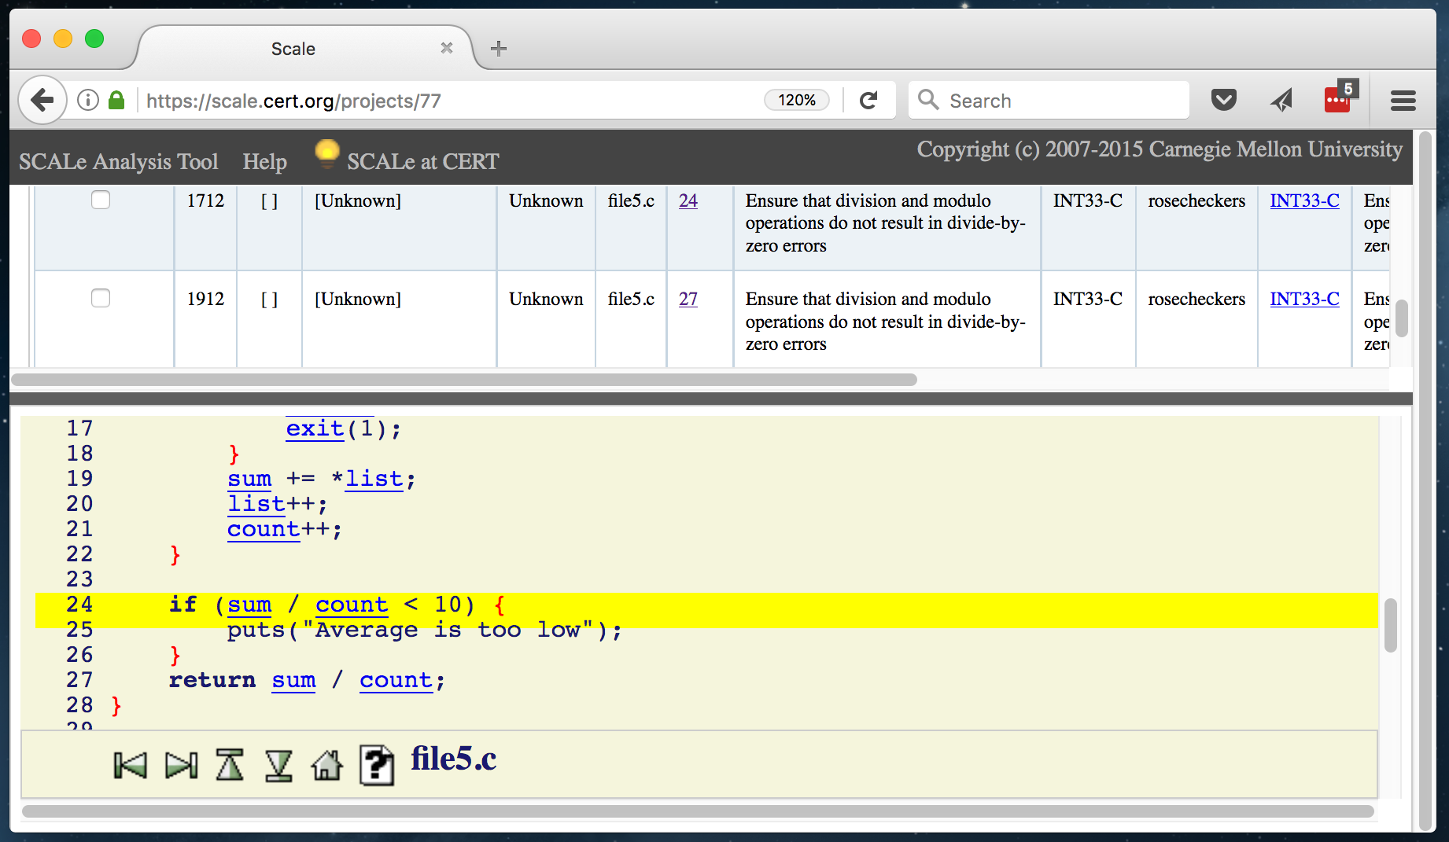
Example

Slide 34
CERT Coding Rule INT33-C

Slide 35
Example
int main(int argc, char **argv) {
int list[10];
int result;
for (int i = 0; i < 10; i++) {
if (i+1 >= argc) {
break;
}
read_integer(argv[i+1], &list[i]);
if (list[i] <= 0) {
break;
}
}
result = compute_int_average(list);
printf("Average is: %d\n", result);
return 0;
}
read_integer() fills 2nd arg with integer value of 1st arg.
Code unchanged from previous example.

Slide 36
The compute_int_average() function
int main(int argc, char **argv) {
int list[10];
int result;
for (int i = 0; i < 10; i++) {
if (i+1 >= argc) {
break;
}
read_integer(argv[i+1], &list[i]);
if (list[i] <= 0) {
break;
}
}
result = compute_int_average(list);
printf("Average is: %d\n", result);
return 0;
}
int compute_int_average(int* list) {
…
if (sum / count < 10) {
puts("Average is too low");
}
return sum / count;
}
New lines, rest of function unchanged

Slide 37
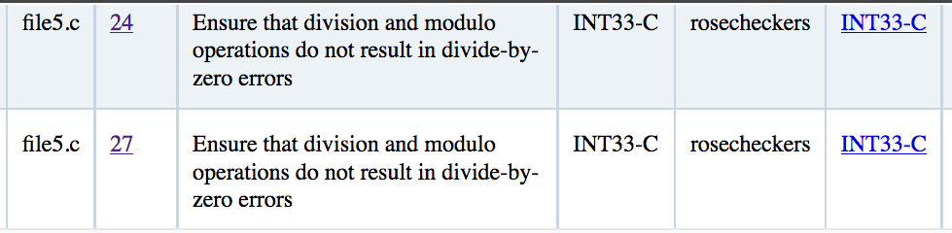
Alerts to Audit
int main(int argc, char **argv) {
int list[10];
int result;
for (int i = 0; i < 10; i++) {
if (i+1 >= argc) {
break;
}
read_integer(argv[i+1], &list[i]);
if (list[i] <= 0) {
break;
}
}
result = compute_int_average(list);
printf("Average is: %d\n", result);
return 0;
}
int compute_int_average(int* list) {
…
if (sum / count < 10) {
puts("Average is too low");
}
return sum / count;
}

Slide 38
Review
We know that count could be 0 during the first division, on line 24.
    This violates INT33-C.
The same division occurs three lines later, on line 27.
Why does this violate INT33-C?
Why doesn’t this violate INT33-C?

Slide 39
Resolution
The first alert is clearly true.
The last alert could not be true unless the first alert is also true.
Therefore the last alert should be marked Dependent.

Slide 40
Marking the Alerts
int main(int argc, char **argv) {
int list[10];
int result;
for (int i = 0; i < 10; i++) {
if (i+1 >= argc) {
break;
}
read_integer(argv[i+1], &list[i]);
if (list[i] <= 0) {
break;
}
}
result = compute_int_average(list);
printf("Average is: %d\n", result);
return 0;
}
int compute_int_average(int* list) {
…
if (sum / count < 10) {
puts("Average is too low");
}
return sum / count;
}
Unknown
Complex
False
Dependent
True
Unknown
Complex
True
False
Dependent

Slide 41
Audit Rules
4. Handle an alert in unreachable code depending on whether it is exportable.

Slide 42
4. Handle an alert in unreachable code depending on whether it is exportable.
Certain code segments may be unreachable at runtime. Also called dead code.
A static analysis tool might not be able to realize this, and still mark alerts in code that cannot be executed.
The Ignored verdict can be applied to these alerts.
However, an auditor should be careful when deciding if a piece of code is truly dead.
In particular: just because a given program module (function, class) is not used does not mean it is dead. The module might be exported as a public interface, for use by another application.
This rule was developed as a result of a scenario encountered by one of our collaborators.

Slide 43
VM Exercise: Make an Alert Determination
Examine the diagnostic alert info at line 40 of the file tutorial/analysis/rosecheckers.txt
Examine the source code at line 24
of the file tutorial/src/file6.c
Examine CERT rule INT33-C in the
SEI Secure Coding Rules PDF,
on page 163.
Study for 2 minutes, then we’ll discuss.
Basic
Unknown
Unknown
Complex
True
False
Dependent
Supplemental
Dangerous
Ignored
Dead
Inapplicable

Slide 44
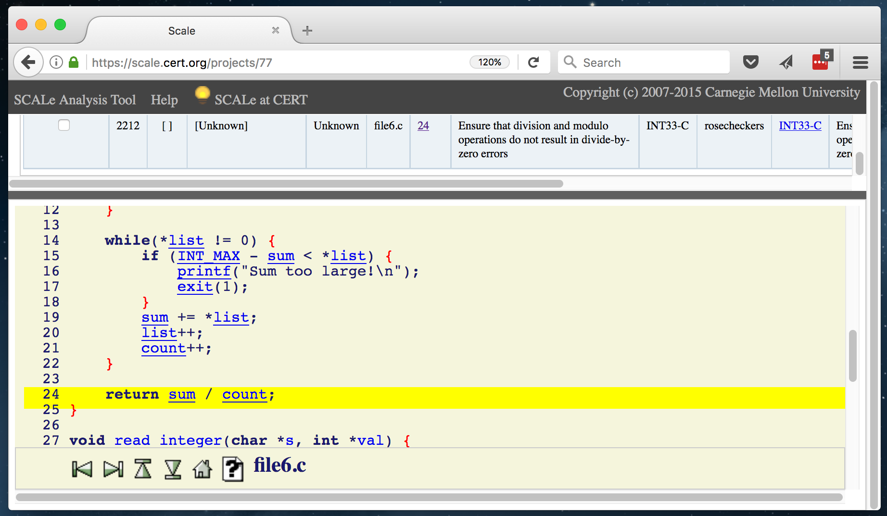
Example

Slide 45
CERT Coding Rule INT33-C

Slide 46
Example
int main(int argc, char **argv) {
int list[10];
int result;
for (int i = 0; i < 10; i++) {
if (i+1 >= argc) {
break;
}
read_integer(argv[i+1], &list[i]);
if (list[i] <= 0) {
break;
}
}
// result = compute_int_average(list);
// printf("Result is: %d\n", result);
return 0;
}
read_integer() fills 2nd arg with integer value of 1st arg.
These lines commented out. No other changes.

Slide 47
The compute_int_average() function
int main(int argc, char **argv) {
int list[10];
int result;
for (int i = 0; i < 10; i++) {
if (i+1 >= argc) {
break;
}
read_integer(argv[i+1], &list[i]);
if (list[i] <= 0) {
break;
}
}
// result = compute_int_average(list);
// printf("Result is: %d\n", result);
return 0;
}
int compute_int_average(int* list) {
int sum = 0;
int count = 0;
if (list == NULL) {
return 0;
}
while (*list != 0) {
if (INT_MAX – sum > *list) {
printf(“Sum too large!\n”);
exit(1);
}
sum += *list;
list++;
count++;
}
return sum / count;
}
No changes to this function

Slide 48
Alert to Audit
int main(int argc, char **argv) {
int list[10];
int result;
for (int i = 0; i < 10; i++) {
if (i+1 >= argc) {
break;
}
read_integer(argv[i+1], &list[i]);
if (list[i] <= 0) {
break;
}
}
// result = compute_int_average(list);
// printf("Result is: %d\n", result);
return 0;
}
int compute_int_average(int* list) {
int sum = 0;
int count = 0;
if (list == NULL) {
return 0;
}
while (*list != 0) {
if (INT_MAX – sum > *list) {
printf(“Sum too large!\n”);
exit(1);
}
sum += *list;
list++;
count++;
}
return sum / count;
}

Slide 49
Recap
Once again, we have what looks like a genuine division by zero.
But, the compute_int_average() function is never actually called. This is dead code.

Slide 50
Marking the Alert
int main(int argc, char **argv) {
int list[10];
int result;
for (int i = 0; i < 10; i++) {
if (i+1 >= argc) {
break;
}
read_integer(argv[i+1], &list[i]);
if (list[i] == 0) {
break;
}
}
// result = compute_int_average(list);
// printf("Result is: %d\n", result);
return 0;
}
int compute_int_average(int* list) {
int sum = 0;
int count = 0;
if (list == NULL) {
return 0;
}
while (*list != 0) {
if (INT_MAX – sum > *list) {
printf(“Sum too large!\n”);
exit(1);
}
sum += *list;
list++;
count++;
}
return sum / count;
}
Complex
True
False
Dependent
Unknown
Dangerous
Ignored
Dead
Inapplicable

Slide 51
Audit Rules
5. An alert might indicate a true violation of the condition it is mapped to, even if the alert’s message is useless or incorrect.

Slide 52
5. An alert might indicate a true violation of the condition it is mapped to, even if the alert’s message is useless or incorrect.
An alert’s message may be correct, yet the alert may be false.
Conversely, the message may be incorrect, yet the alert may be true.
The alert message should be taken as a hint, but the auditor is free to ignore the message when considering an alert.

Slide 53
Audit Rules
6. Mark an alert True even if code maintainers will protest.

Slide 54
6. Mark an alert True even if code maintainers will protest.
Tension between code maintainers and auditors:
Maintainers wish to avoid superfluous changes.
Auditors wish for code security.
Not marking an alert true may constitute a false negative: a security vulnerability that is never recognized or fixed.

Slide 55
Example
Suppose a C program accesses memory 0 (null) because the program runs only on a hardware platform that allows this.
Diagnosing a flaw in the code may result in:
Changing the code (a fix)
Better documentation (better understanding of the platform)
Discussion of what is secure, and allowed.

Slide 56
Audit Rules
7. Unless instructed otherwise, assume code must be portable.

Slide 57
7. Unless instructed otherwise, assume code must be portable.
Ideally you will have one of two portability specifications:
Is this code secure for one particular platform (e.g., 32-bit x86)
Is this code secure for all platforms (e.g., strictly conformant to the ISO C standard)?
If a line of code malfunctions on certain platforms, and in doing so violates a secure coding rule, this is suitable justification for marking the alert true.

Slide 58
Example
One recently-audited C codebase has a pointer that iterates from memory location 0x0 to another hardcoded memory address.
This violates several CERT C rules:
ARR36-C. Do not subtract or compare two pointers that do not refer to the same array
EXP34-C. Do not dereference null pointers
This is embedded code, and it is believed that its platform specifically permits this behavior, as the code would not run otherwise.
So these alerts are true if and only if the code is portable.

Slide 59
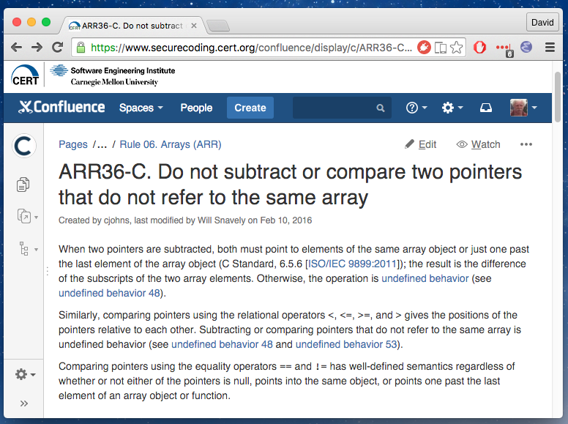
CERT Coding Rule ARR36-C

Slide 60
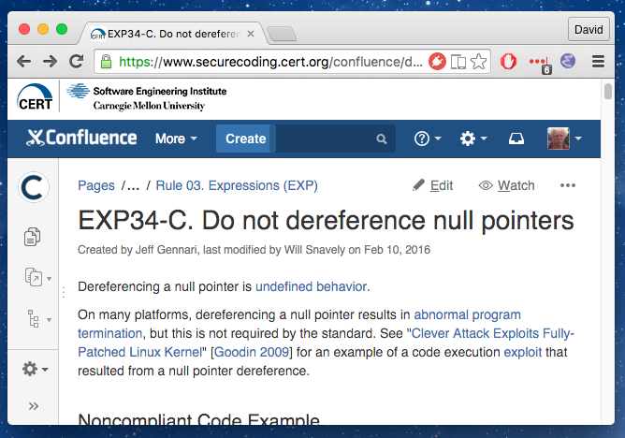
CERT Coding Rule EXP34-C

Slide 61
VM Exercise: Make an Alert Determination
Examine the diagnostic alert info at line 20 of the file tutorial/analysis/rosecheckers.txt
Examine the source code at line 17
of the file tutorial/src/file3.c
Examine CERT rule EXP36-C in the
SEI Secure Coding Rules PDF,
on page 99.
Study for 2 minutes, then we’ll discuss.
Basic
Unknown
Unknown
Complex
True
False
Dependent
Supplemental
Dangerous
Ignored
Dead
Inapplicable

Slide 62
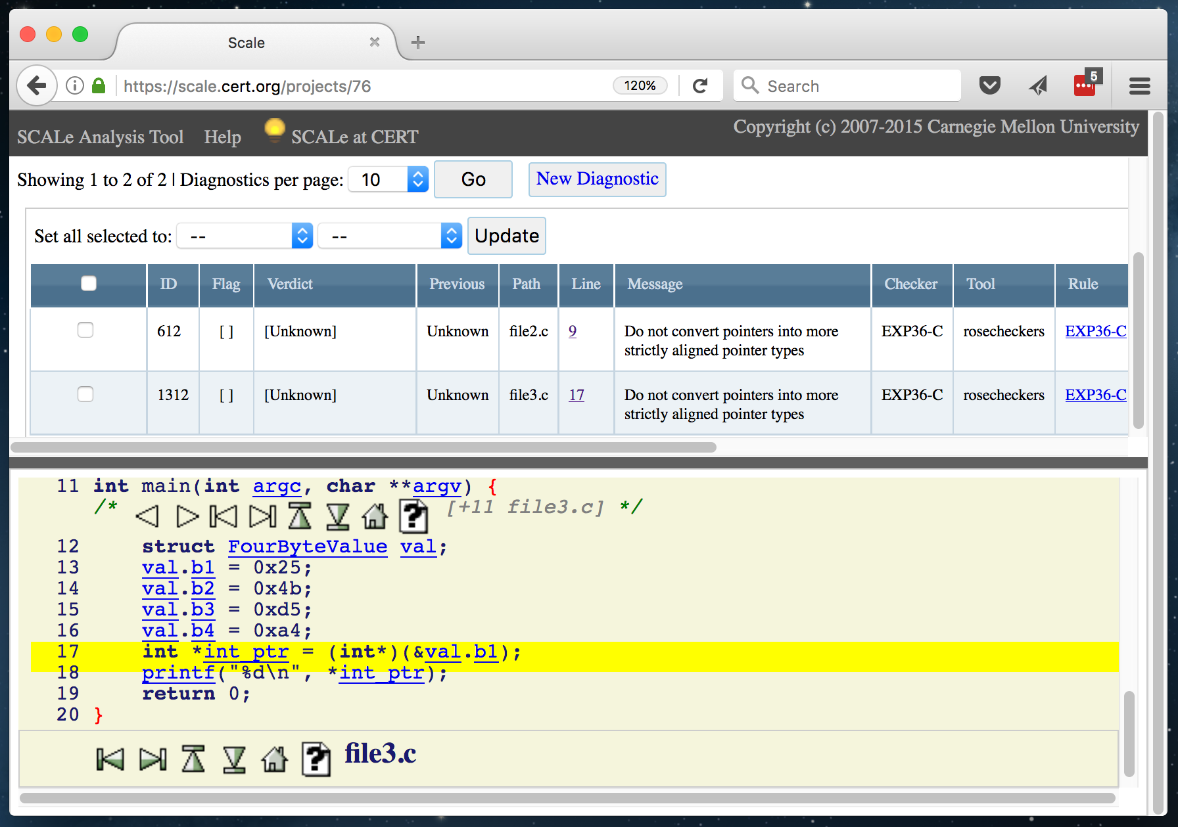
Example

Slide 63
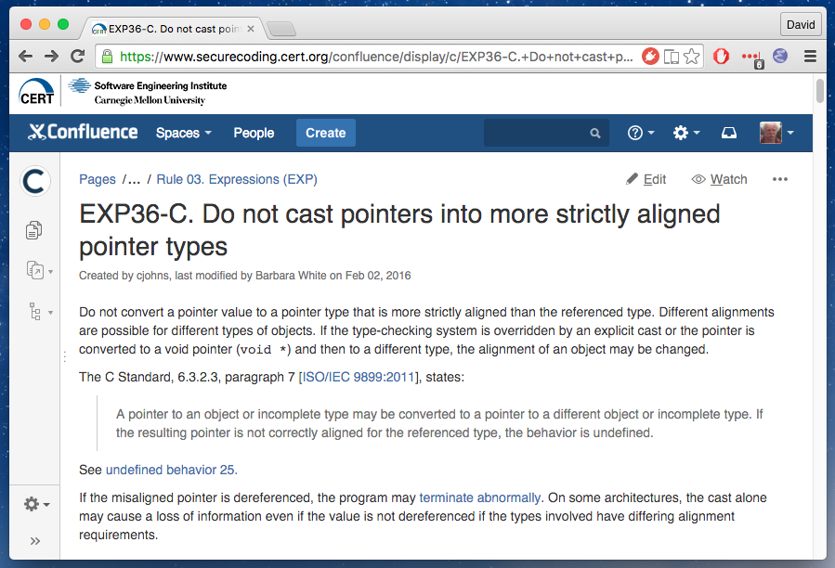
CERT Coding Rule EXP36-C

Slide 64
Example
int main(int argc, char **argv) {
struct FourByteValue val;
val.b1 = 0x25;
val.b2 = 0x4b;
val.b3 = 0xd5;
val.b4 = 0xa4;
int *int_ptr = (int*)(&val.b1);
printf("%d\n", *int_ptr);
return 0;
}
struct FourByteValue {
char b1;
char b2;
char b3;
char b4;
};

Slide 65
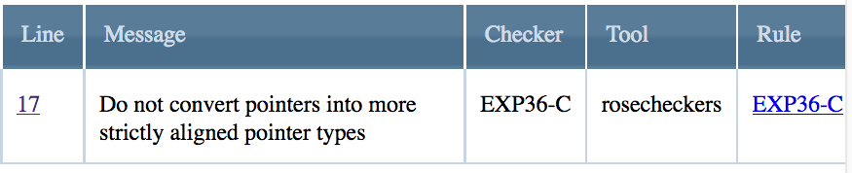
Alert to Audit
int main(int argc, char **argv) {
struct FourByteValue val;
val.b1 = 0x25;
val.b2 = 0x4b;
val.b3 = 0xd5;
val.b4 = 0xa4;
int *int_ptr = (int*)(&val.b1);
printf("%d\n", *int_ptr);
return 0;
}
struct FourByteValue {
char b1;
char b2;
char b3;
char b4;
};
This code works on Intel x86 architectures, but what about others?

Slide 66
Marking the alert
int main(int argc, char **argv) {
struct FourByteValue val;
val.b1 = 0x25;
val.b2 = 0x4b;
val.b3 = 0xd5;
val.b4 = 0xa4;
int *int_ptr = (int*)(&val.b1);
printf("%d\n", *int_ptr);
return 0;
}
struct FourByteValue {
char b1;
char b2;
char b3;
char b4;
};
Unknown
Complex
False
Dependent
True

Slide 67
VM Exercise: Make an Alert Determination
Examine the diagnostic alert info at lines 6 and 7 of the file tutorial/analysis/gcc.txt
Examine the source code at lines 15 and 16
of the file tutorial/src/file3.c
Examine CERT rule INT31-C in the
SEI Secure Coding Rules PDF,
on page 144.
Study for 2 minutes, then we’ll discuss.
Basic
Unknown
Unknown
Complex
True
False
Dependent
Supplemental
Dangerous
Ignored
Dead
Inapplicable

Slide 68
Example
int main(int argc, char **argv) {
struct FourByteValue val;
val.b1 = 0x25;
val.b2 = 0x4b;
val.b3 = 0xd5;
val.b4 = 0xa4;
int *int_ptr = (int*)(&val.b1);
printf("%d\n", *int_ptr);
return 0;
}
struct FourByteValue {
char b1;
char b2;
char b3;
char b4;
};
Code unchanged

Slide 69
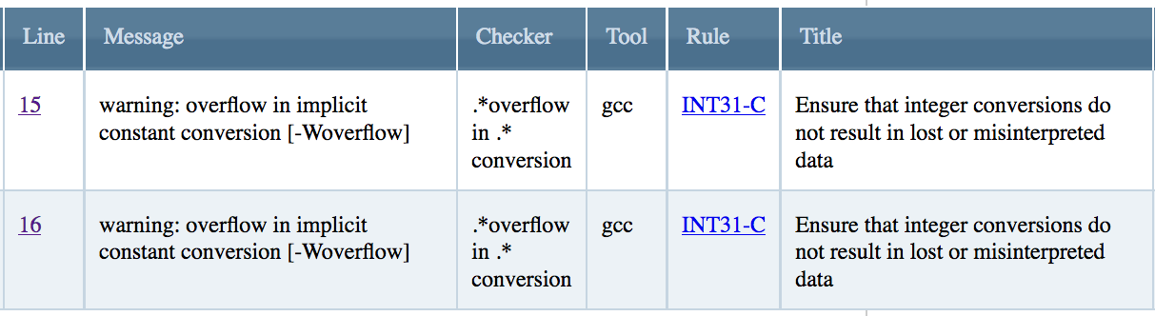
Alerts to Audit
int main(int argc, char **argv) {
struct FourByteValue val;
val.b1 = 0x25;
val.b2 = 0x4b;
val.b3 = 0xd5;
val.b4 = 0xa4;
int *int_ptr = (int*)(&val.b1);
printf("%d\n", *int_ptr);
return 0;
}
struct FourByteValue {
char b1;
char b2;
char b3;
char b4;
};
What happens on platforms where plain char is signed?

Slide 70
Marking the alerts
int main(int argc, char **argv) {
struct FourByteValue val;
val.b1 = 0x25;
val.b2 = 0x4b;
val.b3 = 0xd5;
val.b4 = 0xa4;
int *int_ptr = (int*)(&val.b1);
printf("%d\n", *int_ptr);
return 0;
}
struct FourByteValue {
char b1;
char b2;
char b3;
char b4;
};
Unknown
Complex
False
Dependent
True
Unknown
Complex
False
Dependent
True

Slide 71
Audit Rules
8. When auditing an alert, if a second true violation is discovered, its alert should be marked True.

Slide 72
8. When auditing an alert, if a second true violation is discovered, its alert should be marked True.
Common occurrence for experienced auditors.
Second violation might be:
Same line as first alert, but different rule
Different line as first alert

Slide 73
Resolution
If you have been instructed to focus on the second violation’s rule:
Produce an alert entry associated with the second violation and mark it as true.
  This requires finding an appropriate alert or creating one.
Otherwise, ignore the second violation.
Notes:
The rules “you are instructed to focus on” will depend on the situation.
AFBs only should focus on the 8 “rules of interest”: EXP33-C EXP34-C EXP36-C ARR36-C INT31-C INT33-C DCL31-C STR31-C
For full audits, focus on all rules.

Slide 74
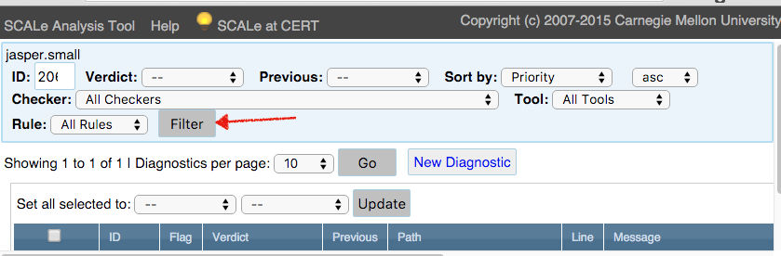
Producing an Alert for a Violation
First, try to find an existing alert associated with the violation.
A suitable alert should share the violation’s:
  Condition
  Path
  Line number
E.g., there are filters in the CERT SCALe web app to help you.

Slide 75
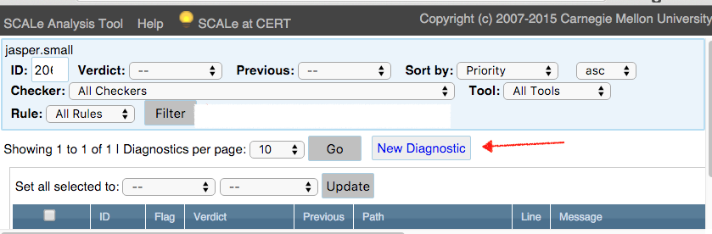
Creating an Alert Manually
Useful when you discover a condition without an associated alert.

Slide 76
After Second Alert is Handled
Do not mark the original alert as true unless it is independently true, even if the second violation involves the same line of code.

Slide 77
VM Exercise: Make an Alert Determination
Examine the diagnostic alert info at line 1427 of the file
jasper/analysis/rosecheckers.txt
Examine the source code at line 2105
of the file jasper/src/src/libjasper
/jpc/jpc_enc.c
Examine CERT rule MEM35-C in the
SEI Secure Coding Rules PDF,
on page 279.
Study for 2 minutes, then we’ll discuss.
Basic
Unknown
Unknown
Complex
True
False
Dependent
Supplemental
Dangerous
Ignored
Dead
Inapplicable

Slide 78
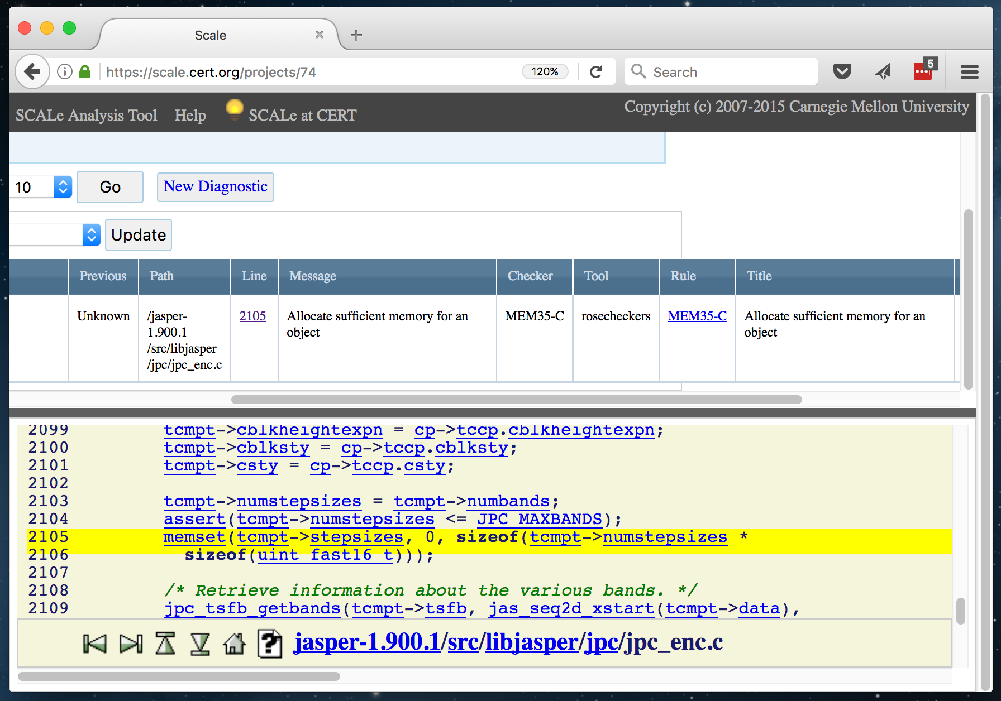
Example

Slide 79
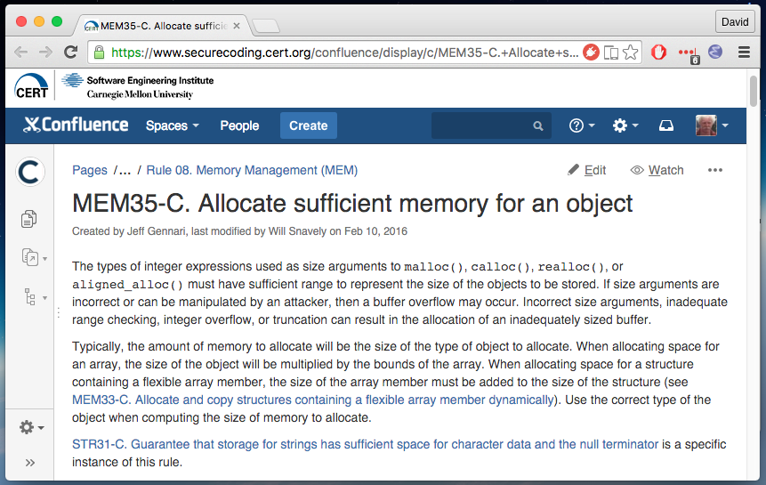
CERT Coding Rule MEM35-C

Slide 80
Example
memset(
tcmpt->stepsizes,
0,
sizeof(tcmpt->numstepsizes * sizeof(uint_fast16_t)));

Slide 81
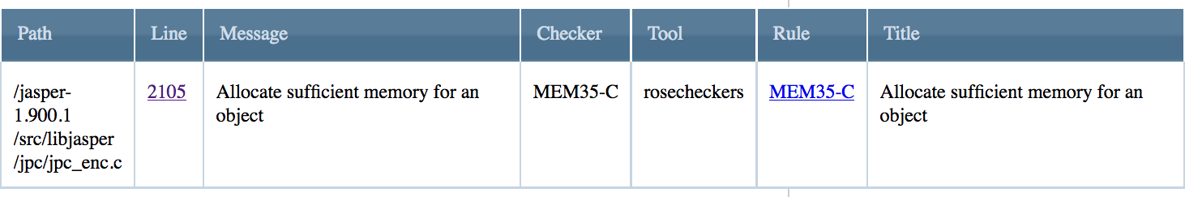
Alert to Audit
memset(
tcmpt->stepsizes,
0,
sizeof(tcmpt->numstepsizes * sizeof(uint_fast16_t)));
This is a suspicious argument to sizeof.
We expect the name of a type, not a product.
Badly-placed parentheses!

Slide 82
Bad sizeof expression
Performing a multiplication within a sizeof expression will produce an incorrect size value.
But this is not a violation of MEM35-C, which deals with allocating memory, not zeroing out memory
Sending that size value to memset() must violate some rule, but which one?

Slide 83
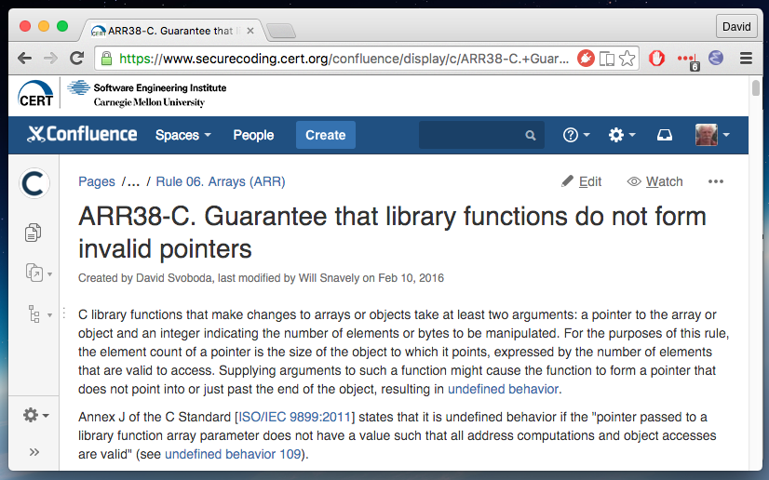
CERT Coding Rule ARR38-C

Slide 84
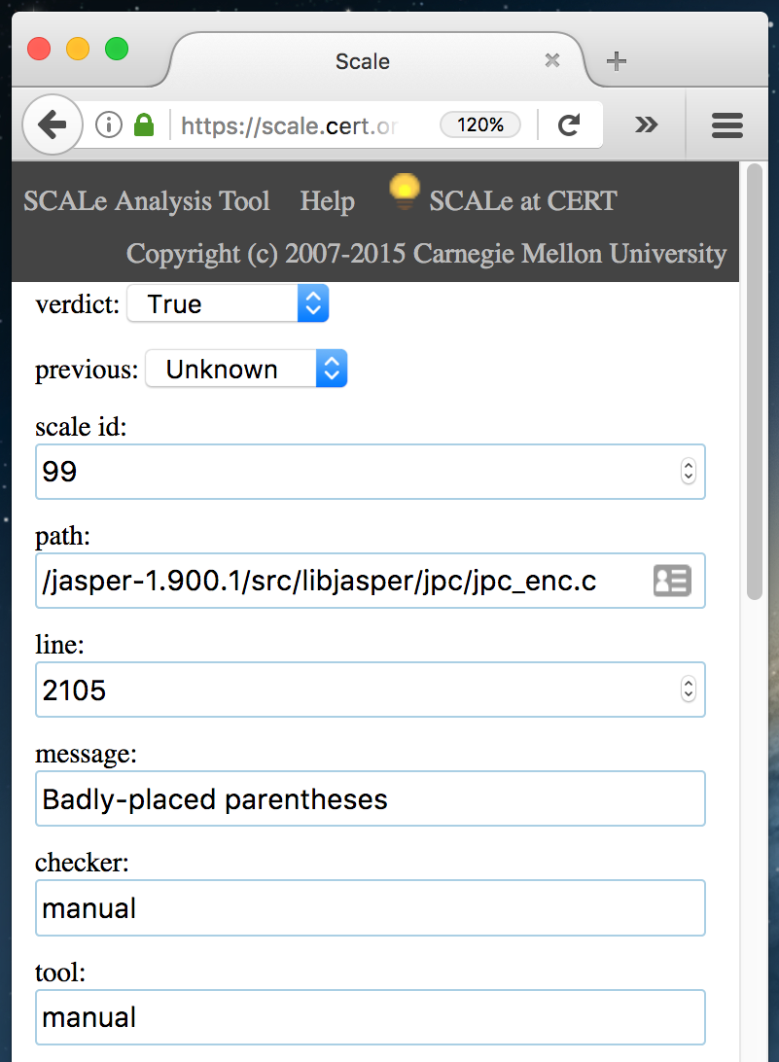
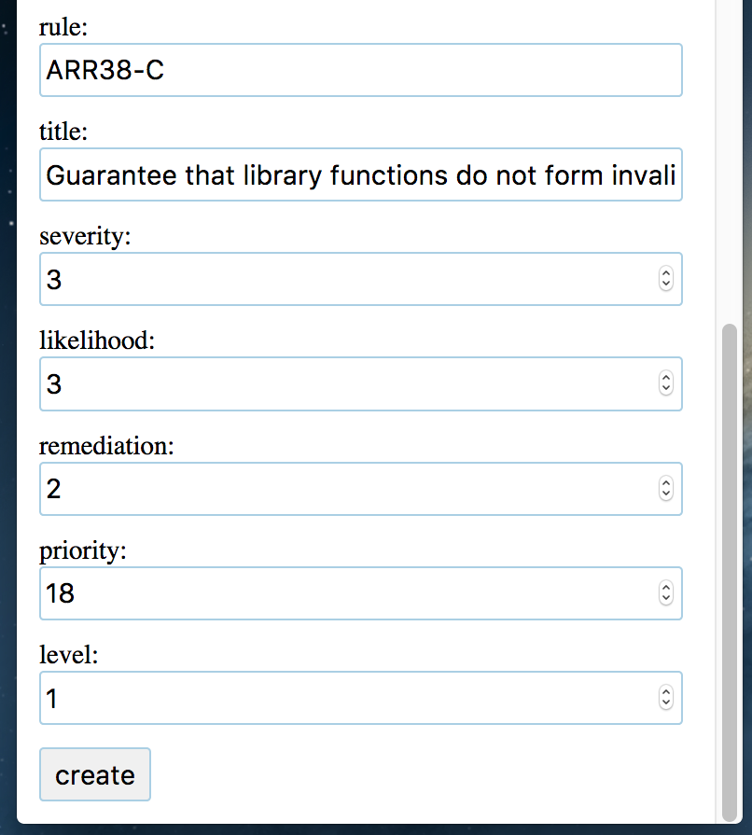
Creating the New Alert
Set to true.
Must be unique
Fill in details about the CERT rule.
Same path & line
Something useful

Slide 85
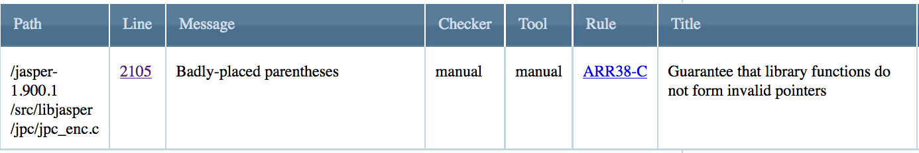
Marking the New Alert
memset(
tcmpt->stepsizes,
0,
sizeof(tcmpt->numstepsizes * sizeof(uint_fast16_t)));
This is a suspicious argument to sizeof.
We expect the name of a type, not a product.
Badly-placed parentheses!
Unknown
Complex
False
Dependent
True

Slide 86
Marking the Original Alert
Unknown
Complex
True
Dependent
False

Slide 87
Audit Rules
9. Auditors must understand the language and the current alert’s condition.

Slide 88
9. Auditors must understand the language and the current alert’s condition.
For any codebase, an auditor must understand:
The codebase language
  Language specification
  Compiler and it’s extensions
Condition taxonomy
  CWE or CERT Coding Standard
Execution Environment
  Operating System
  Hardware
To gain experience quickly:
  Focus on one condition (single item from a taxonomy).
  Audit many alerts for just that one condition.
  Move to another condition, repeat.

Slide 89
Language Standards
Language | Specification | Governing Body | SEI/CERT Standard
C | C11, C99, C90 | ISO/ IEC JTC1/SC22/WG14 | SEI CERT C Coding Standard
C++ | C++11, C++97 | ISO/ IEC JTC1/SC22/WG21 | SEI CERT C++ Coding Standard
Java | Java Language Specification | Oracle Corporation | SEI CERT Oracle Coding Standard for Java
Perl | www.perl.org | Larry Wall | SEI CERT Perl Coding Standard
Many languages have a specification, as well as associated secure coding taxonomy
CERT Secure Coding Standards used in these slides.
Notes:
Table Templates
We have provided some pre-formatted tables as guides for data display.
Columns and Rows are independent and can be edited, added, deleted and formatted to suit your individual needs.
Table Templates are for guidance only.

Slide 90
VM Exercise: Make an Alert Determination
Examine the diagnostic alert info at line 15 of the file tutorial/analysis/rosecheckers.txt
Examine the source code at line 9
of the file tutorial/src/file2.c
Examine CERT rule EXP36-C in the
SEI Secure Coding Rules PDF,
on page 99.
Study for 2 minutes, then we’ll discuss.
Basic
Unknown
Unknown
Complex
True
False
Dependent
Supplemental
Dangerous
Ignored
Dead
Inapplicable

Slide 91
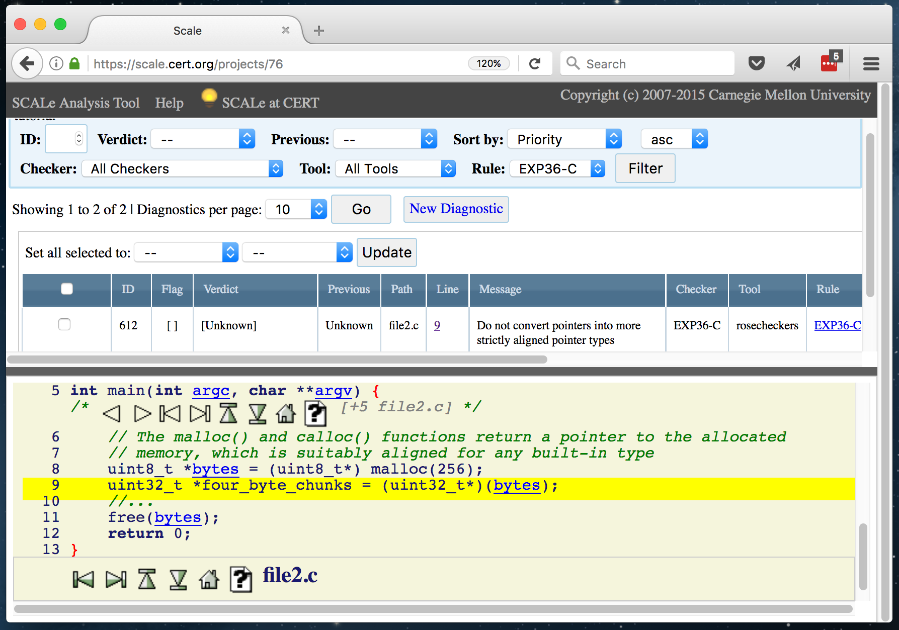
Example

Slide 92
CERT Coding Rule EXP36-C

Slide 93
Example
int main(int argc, char **argv) {
uint8_t *bytes = (uint8_t*) malloc(256);
uint32_t *four_byte_chunks = (uint32_t*)(bytes);
…
free(bytes);
return 0;
}

Slide 94
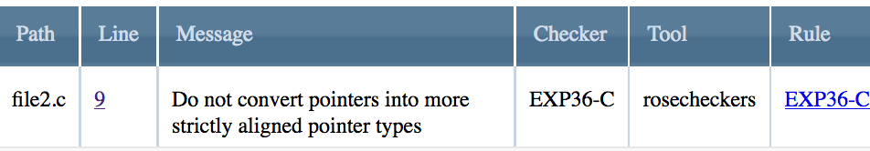
Alert to Audit
int main(int argc, char **argv) {
uint8_t *bytes = (uint8_t*) malloc(256);
uint32_t *four_byte_chunks = (uint32_t*)(bytes);
…
free(bytes);
return 0;
}

Slide 95
More Information
int main(int argc, char **argv) {
uint8_t *bytes = (uint8_t*) malloc(256);
uint32_t *four_byte_chunks = (uint32_t*)(bytes);
…
free(bytes);
return 0;
}
C11, s7.22.3 (Memory management functions), p1, says:
The pointer returned if the allocation succeeds is suitably aligned so that it may be assigned to a pointer to any type of object with a fundamental alignment requirement and then used to access such an object or an array of such objects in the space allocated (until the space is explicitly deallocated).

Slide 96
Marking the Alert
int main(int argc, char **argv) {
uint8_t *bytes = (uint8_t*) malloc(256);
uint32_t *four_byte_chunks = (uint32_t*)(bytes);
…
free(bytes);
return 0;
}
Unknown
Complex
True
Dependent
False

Slide 97
Audit Rules
10. Do not arbitrarily extend the scope of a condition.

Slide 98
10. Do not arbitrarily extend the scope of a condition.
If a line of code is judged insecure but does not violate the condition in question:
Mark the alert false.
The line of code probably violates a different condition. Apply rule #8:
  8. When auditing an alert, if a second true violation is discovered, its alert should be marked True.

Slide 99
Audit Rules
11. Code that behaves as expected might still violate a condition.

Slide 100
11. Code that behaves as expected might still violate a condition.
Do not assume code is secure simply because it seems to be working.

Slide 101
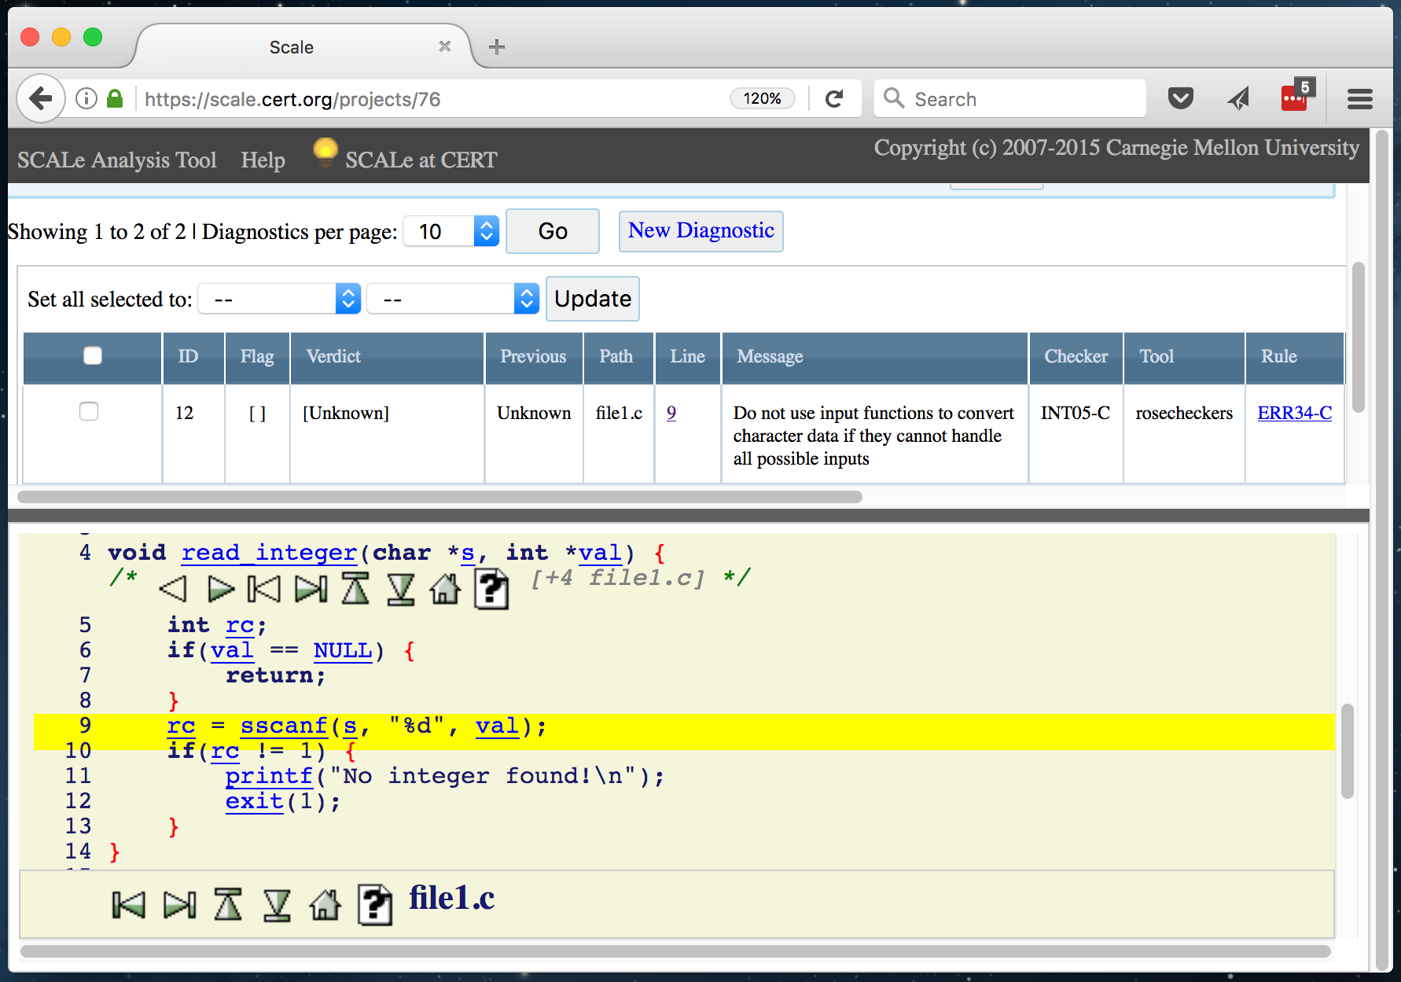
Example

Slide 102
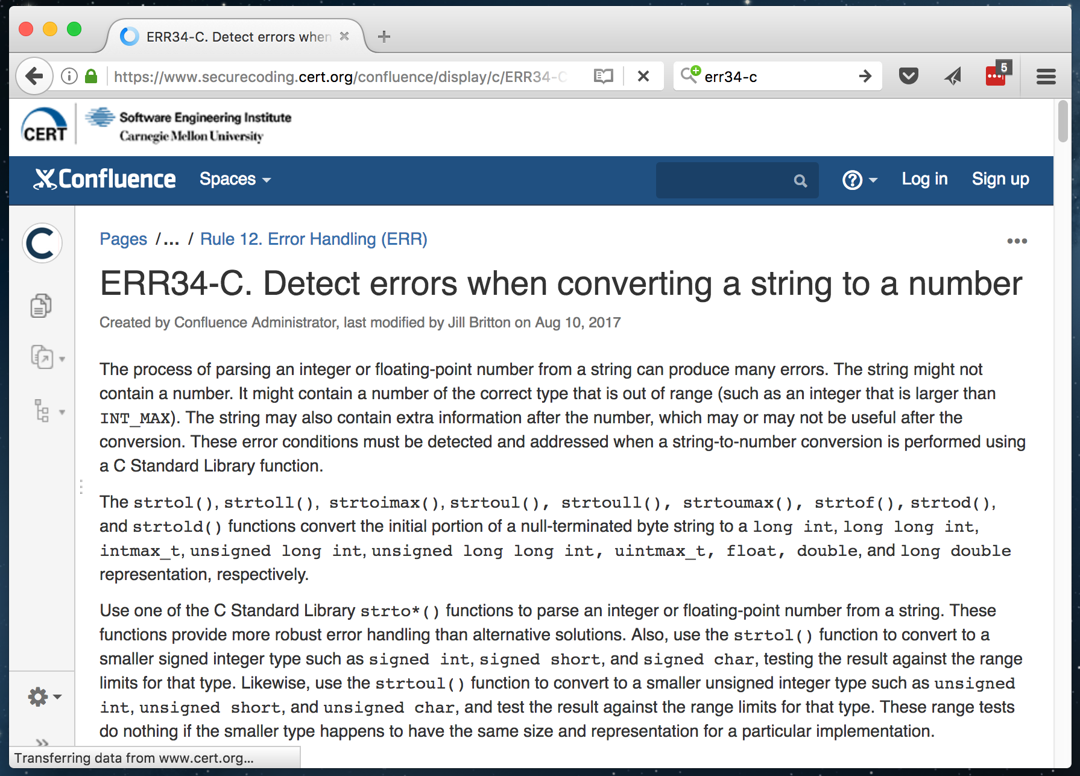
CERT Coding Rule ERR34-C

Slide 103
Example
void read_integer(char *s, int *val) {
int rc;
if (val == NULL) {
return;
}
rc = sscanf(s, "%d", val);
if (rc != 1) {
printf("No integer found!\n");
exit(1);
}
}

Slide 104
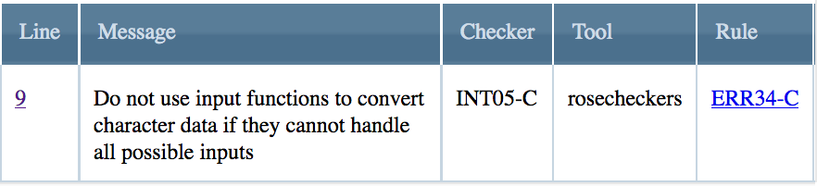
Alert to Audit
void read_integer(char *s, int *val) {
int rc;
if (val == NULL) {
return;
}
rc = sscanf(s, "%d", val);
if (rc != 1) {
printf("No integer found!\n");
exit(1);
}
}
What happens if the input is a numeric value outside the range of signed int?

Slide 105
Marking the Alert
void read_integer(char *s, int *val) {
int rc;
if (val == NULL) {
return;
}
rc = sscanf(s, "%d", val);
if (rc != 1) {
printf("No integer found!\n");
exit(1);
}
}
Unknown
Complex
False
Dependent
True

Slide 106
Audit Rules
12. Multiple messages help in understanding an alert.

Slide 107
12. Multiple messages help in understanding an alert.
Many alerts produce multiple messages.
  A tool may offer a function trace to justify an alert.
  A tool may have independent checkers that both report an alert.
  Multiple tools may produce the same alert with different messages.

Slide 108


For More Information
Lori Flynn Email: lflynn@cert.org David Svoboda Email: svoboda@cert.org William Snavely Email: wsnavely@cert.org | U.S. Mail Software Engineering Institute Customer Relations 4500 Fifth Avenue Pittsburgh, PA 15213-2612 USA
Web www.cert.org/secure-coding www.securecoding.cert.org | Subscribe to the CERT Secure Coding eNewsletter Mail to: info@sei.cmu.edu

